Slide 1
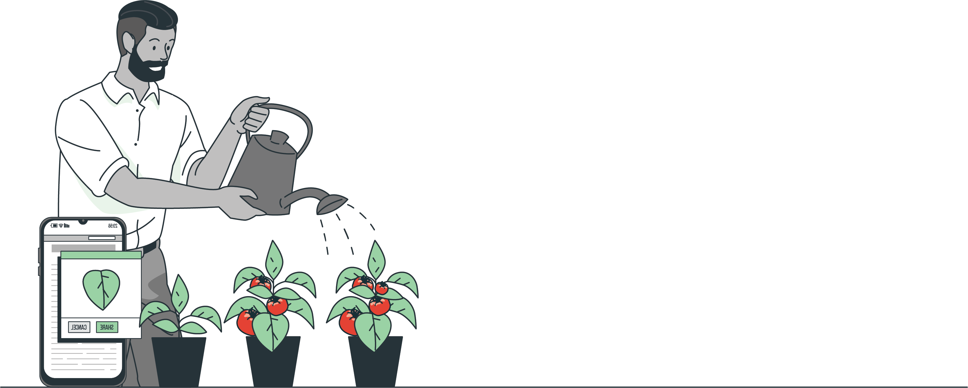
Digital Farmers: Harvesting Insights to Tackle Leaf Disease
Early Detection of Tomato Plant Diseases using Machine Learning
By Seward Richard Mupereri - 20140175
Notes:
"Good afternoon everyone. My name is Seward Richard Mupereri, and today I will be presenting my project titled 'Digital Farmers: Harvesting Insights to Tackle Leaf Diseases.' This project focuses on the early detection of tomato plant diseases using machine learning and cloud technology. Thank you for taking the time to join me today."

Slide 2

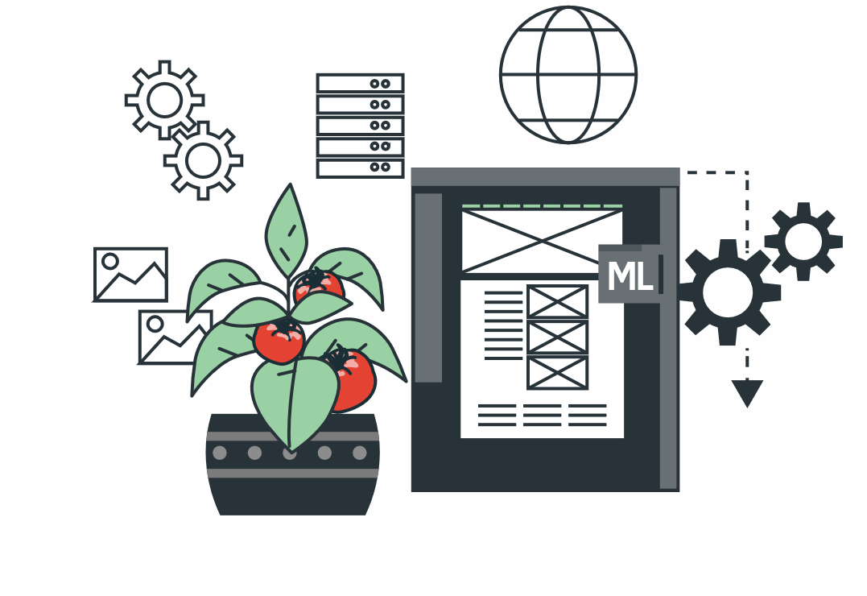
Introduction
Overview of the project objectives
Importance of early disease detection
Emphasis on software development and integration
Notes:
"To begin, let me provide a brief overview of the project. The primary objective of this project is to develop a system that can detect diseases in tomato plants at an early stage using machine learning techniques. Early detection of plant diseases is crucial for several reasons. It helps farmers take timely actions to prevent the spread of diseases, reduces the need for chemical treatments, and ultimately leads to healthier crops and better yields. Additionally, this project places a significant emphasis on the software development process, ensuring the seamless integration of various subsystems to create a cohesive and efficient solution. By leveraging modern technology, this project aims to support sustainable agriculture and improve the livelihoods of farmers through a well-structured and well developed software solution."

Slide 3
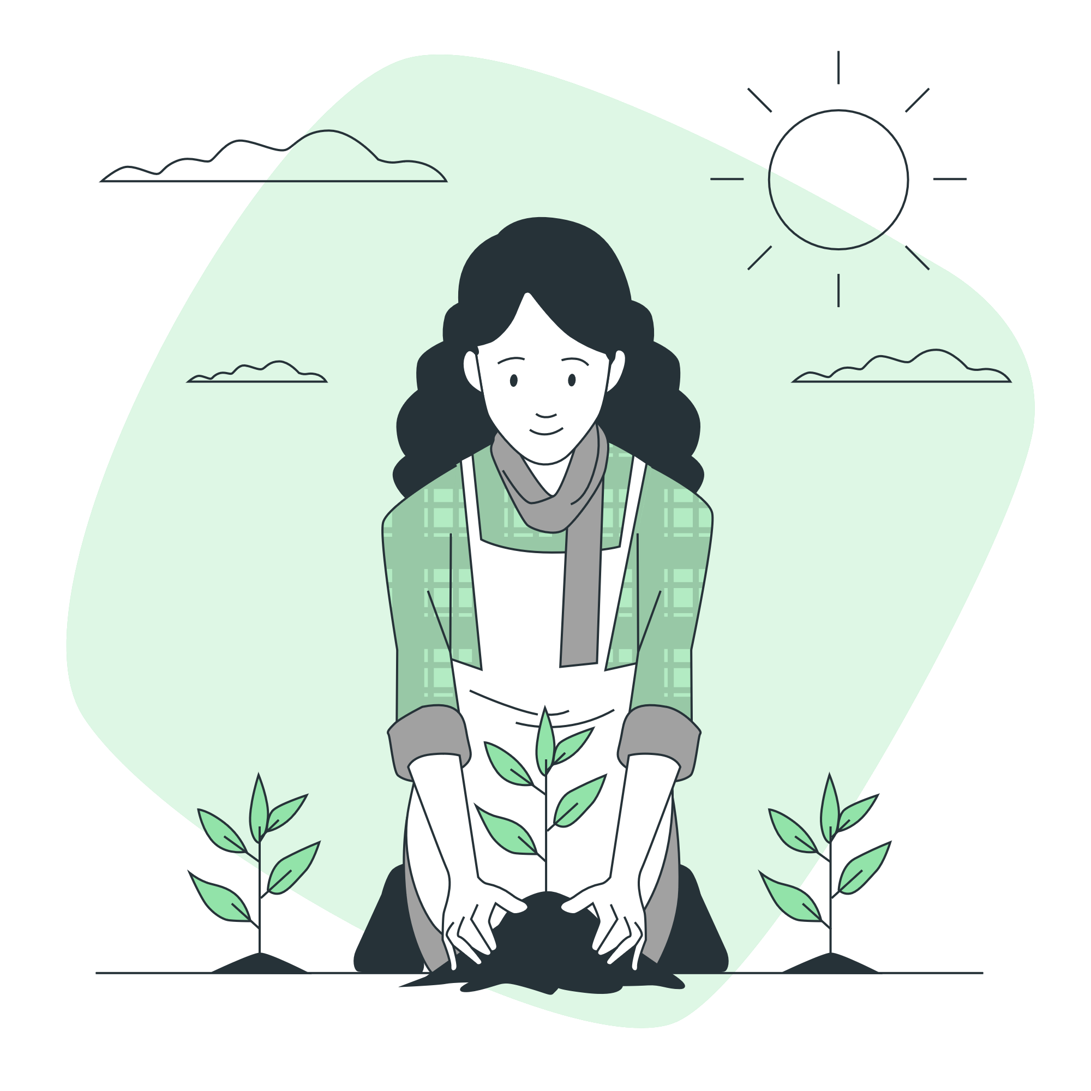
Problem Definition
Challenges faced by tomato farmers:
Rapid spread of diseases
Difficulty in timely detection
Economic and environmental impacts
Financial losses due to crop damage
Increased use of chemical treatments
Need for early detection solutions
Prevent extensive damage
Reduce environmental impact
Notes:
"Now, let's define the problem this project addresses.
Tomato farmers face significant challenges, including the rapid spread of diseases that can devastate crops.
These diseases not only affect the yield but also have economic and environmental impacts, leading to financial losses for farmers and increased use of chemical treatments that can harm the environment. There is a pressing need for early detection solutions that can help farmers identify and manage diseases before they cause extensive damage.
This project aims to provide such a solution by leveraging machine learning to detect diseases early and accurately."

Slide 4
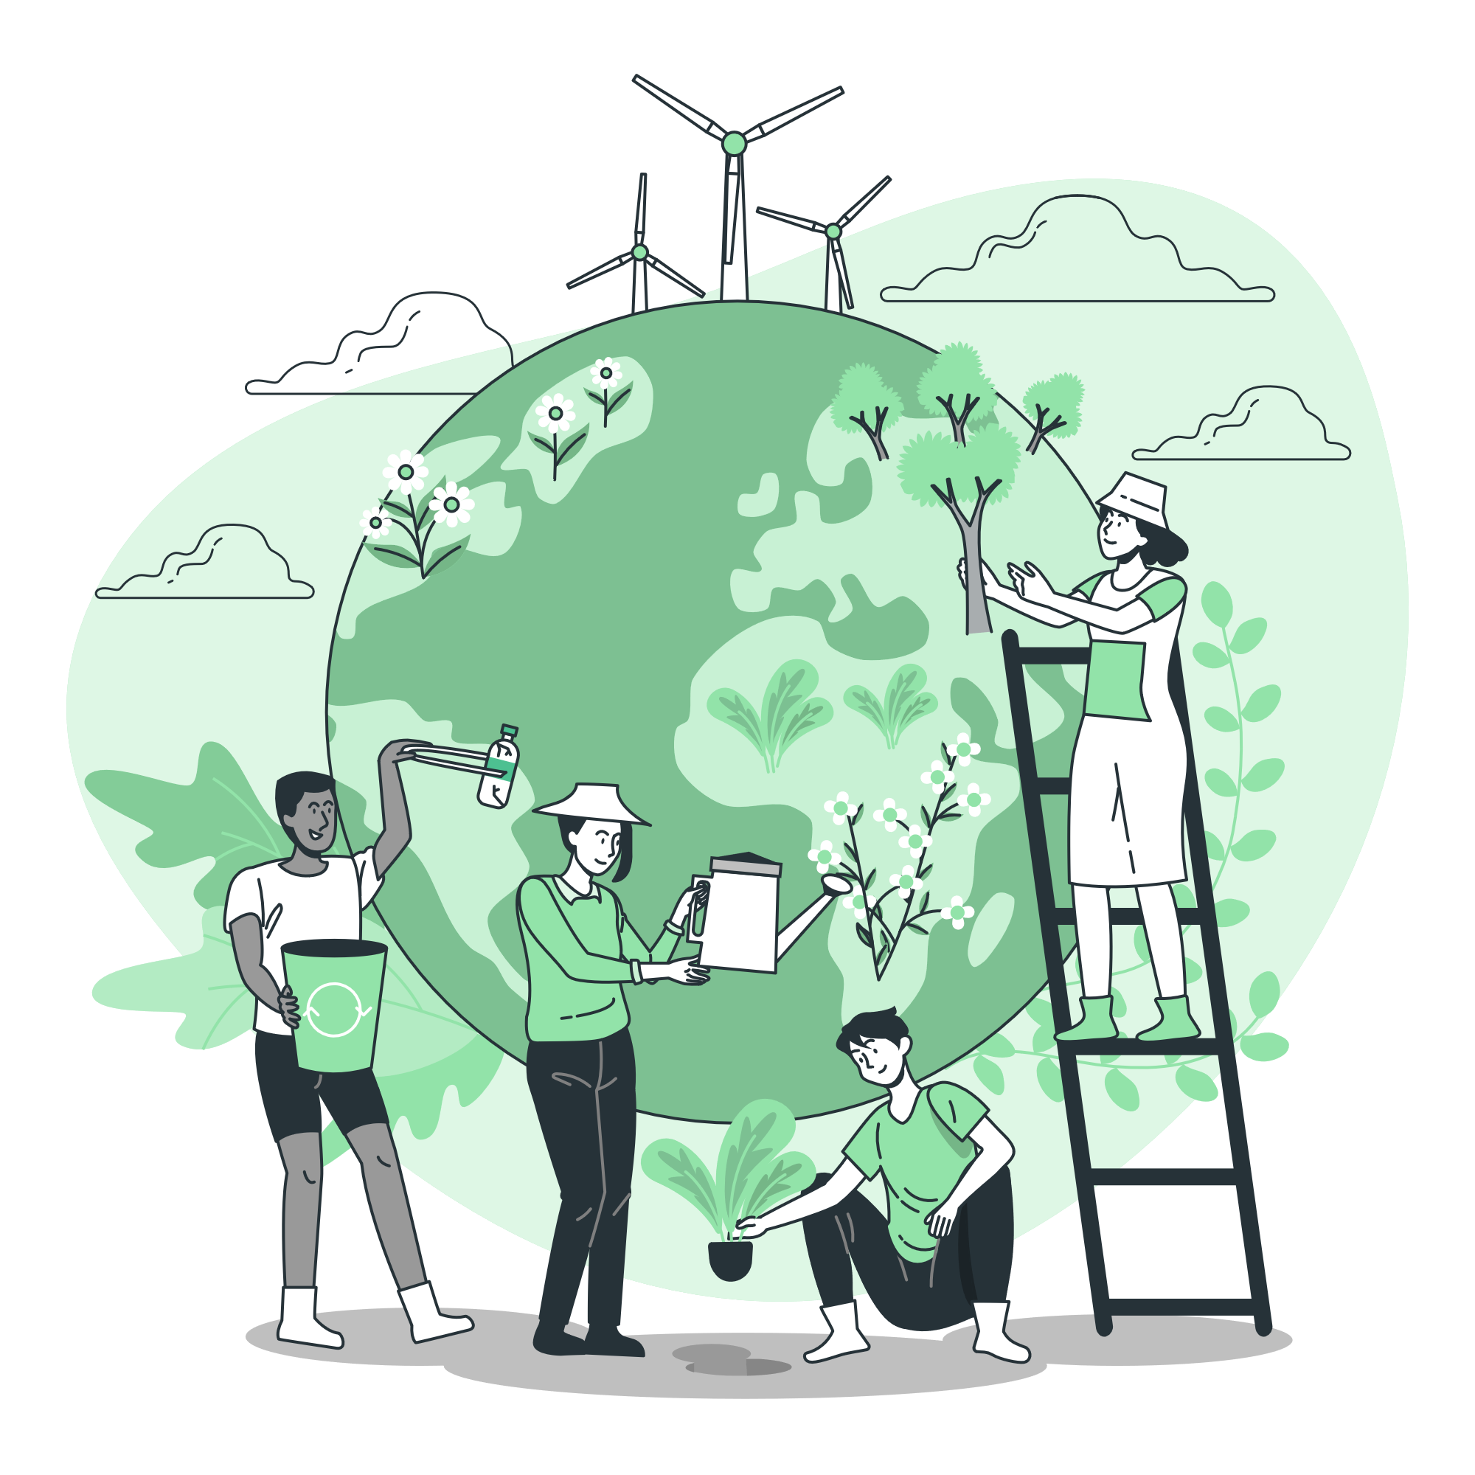
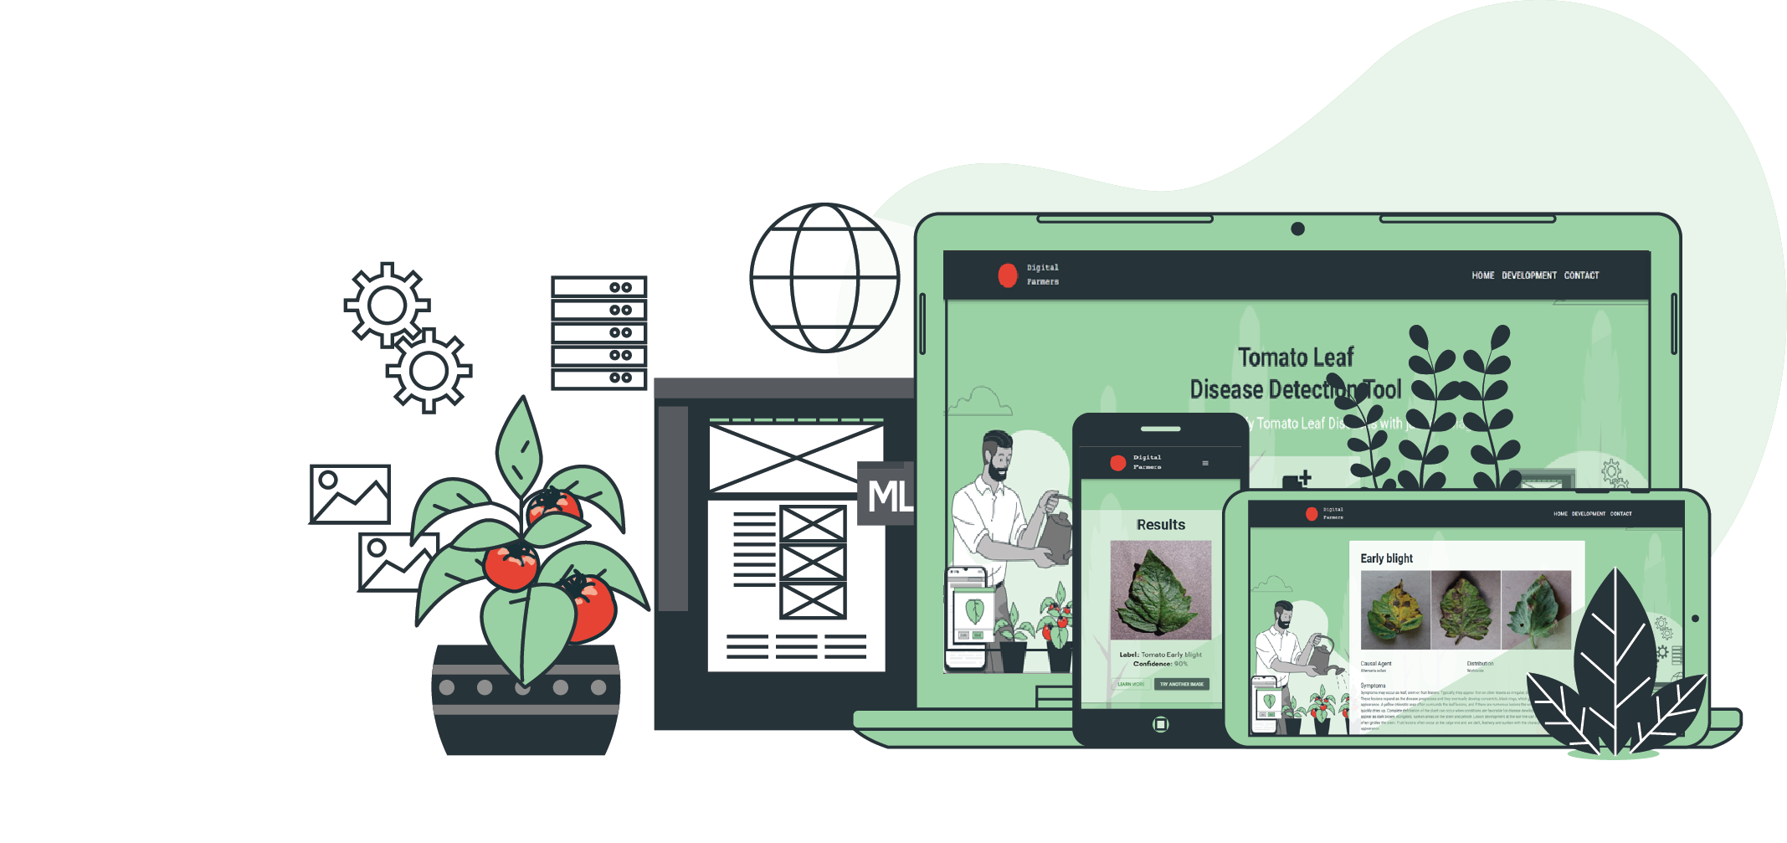
Project Goals
Main Goals
Develop early disease detection system
Promote sustainable agriculture
Create a user-friendly interface
Notes:
“There are 3 main goals for this project.
First, we aim to develop an early disease detection system that can accurately identify tomato plant diseases using machine learning.
Second, we want to promote sustainable agriculture by reducing the reliance on chemical treatments and improving crop yields.
Finally, we strive to create a user-friendly interface that allows farmers to easily use the system and obtain actionable insights.
By achieving these goals, we can help farmers manage their crops more effectively and sustainably."

Slide 5

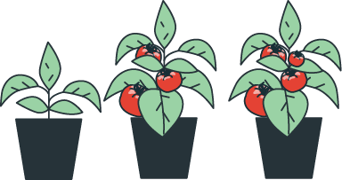
Literature Survey
Project 1
Project 2
Project 3
Uses computer vision and machine learning
Focuses on 5 plant types
Flask-based web application
Uses PyTorch for convolutional neural networks
Classifies 39 different categories
Broader scope than our project
Smart farming app with IoT and AI
Flutter for Android, Firebase for backend
Disease detection and farm management
More features but less focus on tomato plants
Notes:
"In my literature survey, i examined three similar projects to benchmark my approach:
Plant Disease Detection Using Image Processing and Machine Learning: This project uses computer vision and machine learning to detect plant diseases across five different plant types. It employs a Flask-based web application for user interaction. Our project narrows this scope to focus solely on tomato plants, allowing for greater specificity and potentially higher accuracy.
Plant-Disease-Detection: This GitHub-hosted project uses PyTorch to implement convolutional neural networks for plant disease detection, classifying images into 39 categories. Although this project covers a broader range, our focus on tomato plants enables us to fine-tune our model more precisely for this crop.
Farmassist: Farmassist is a smart farming app that integrates IoT and AI to detect plant diseases and manage farm data. Developed using Flutter for Android and Firebase for the backend, it offers a wide range of features, including disease detection and IoT monitoring. While Farmassist provides a comprehensive solution for various plants, our project is distinguished by its specific emphasis on tomato plants and its web-based platform.

Slide 6


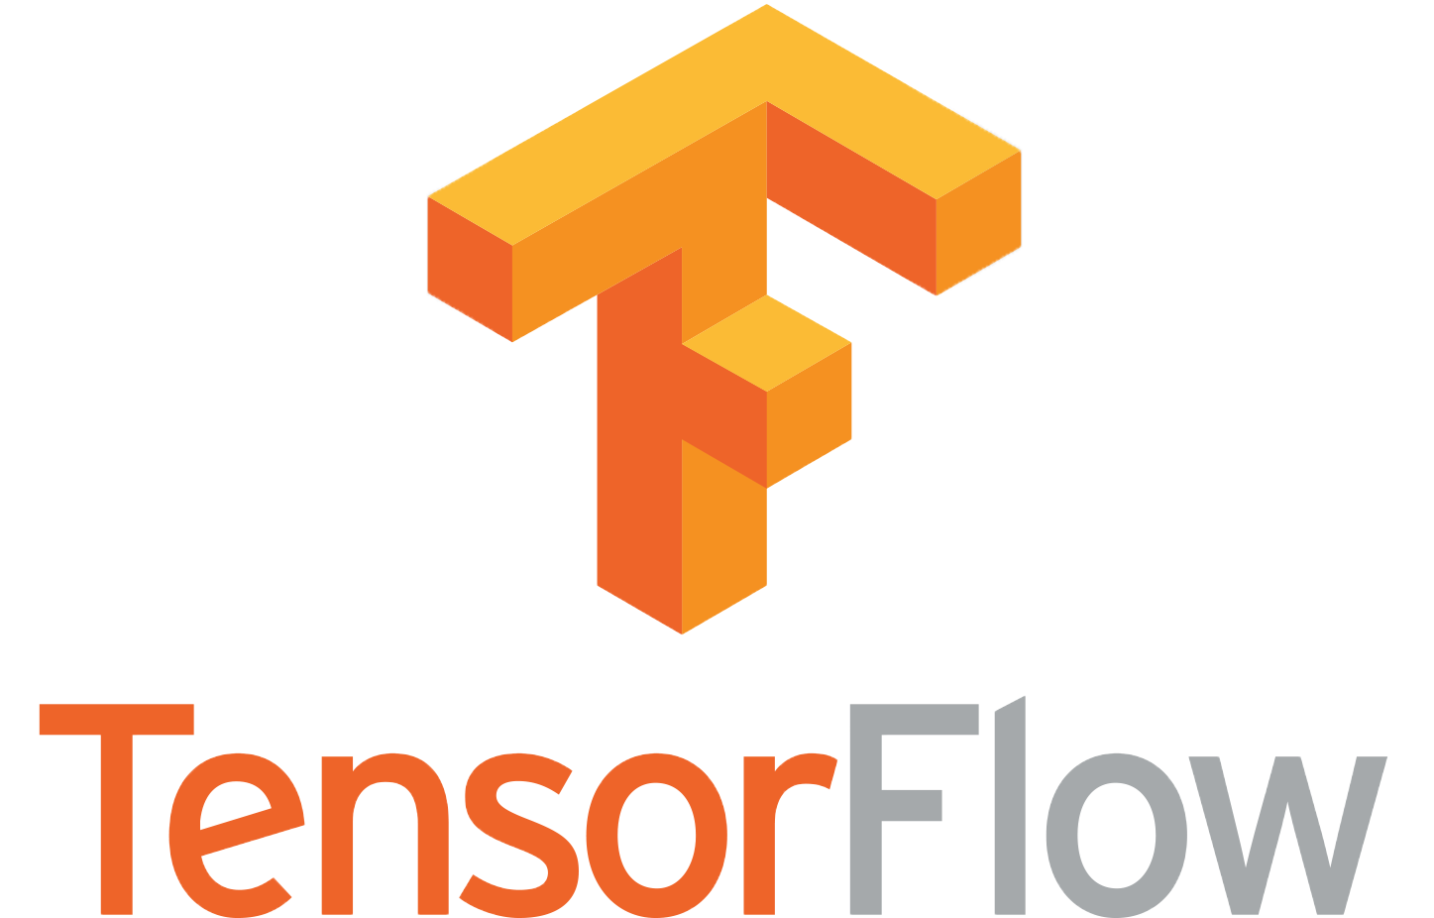


Background Information
Software and Tools Used:
TensorFlow, Keras for machine learning
FastAPI for backend
ReactJS for frontend
Material-UI for design components
Render for deployment
Data Sources and Collection Methods:
Kaggle dataset: PlantVillage
Data preprocessing techniques: normalization, augmentation
Notes:
"In the background information section, we take a look the software and tools used, as well as the data sources and collection methods.
For this project, i used TensorFlow and Keras for developing and training the machine learning models, FastAPI for building the backend API, and ReactJS for the frontend interface.
I also utilized Material-UI for design components to create a visually appealing and user-friendly interface.
The primary data source for this project was the PlantVillage dataset available on Kaggle. This dataset provided a large number of labeled images of tomato leaves with various diseases which were already well prepared to be used for machine learning.
I applied data preprocessing techniques such as normalization and augmentation to improve the quality and diversity of our training data, which helped enhance the model's performance and robustness."

Slide 7
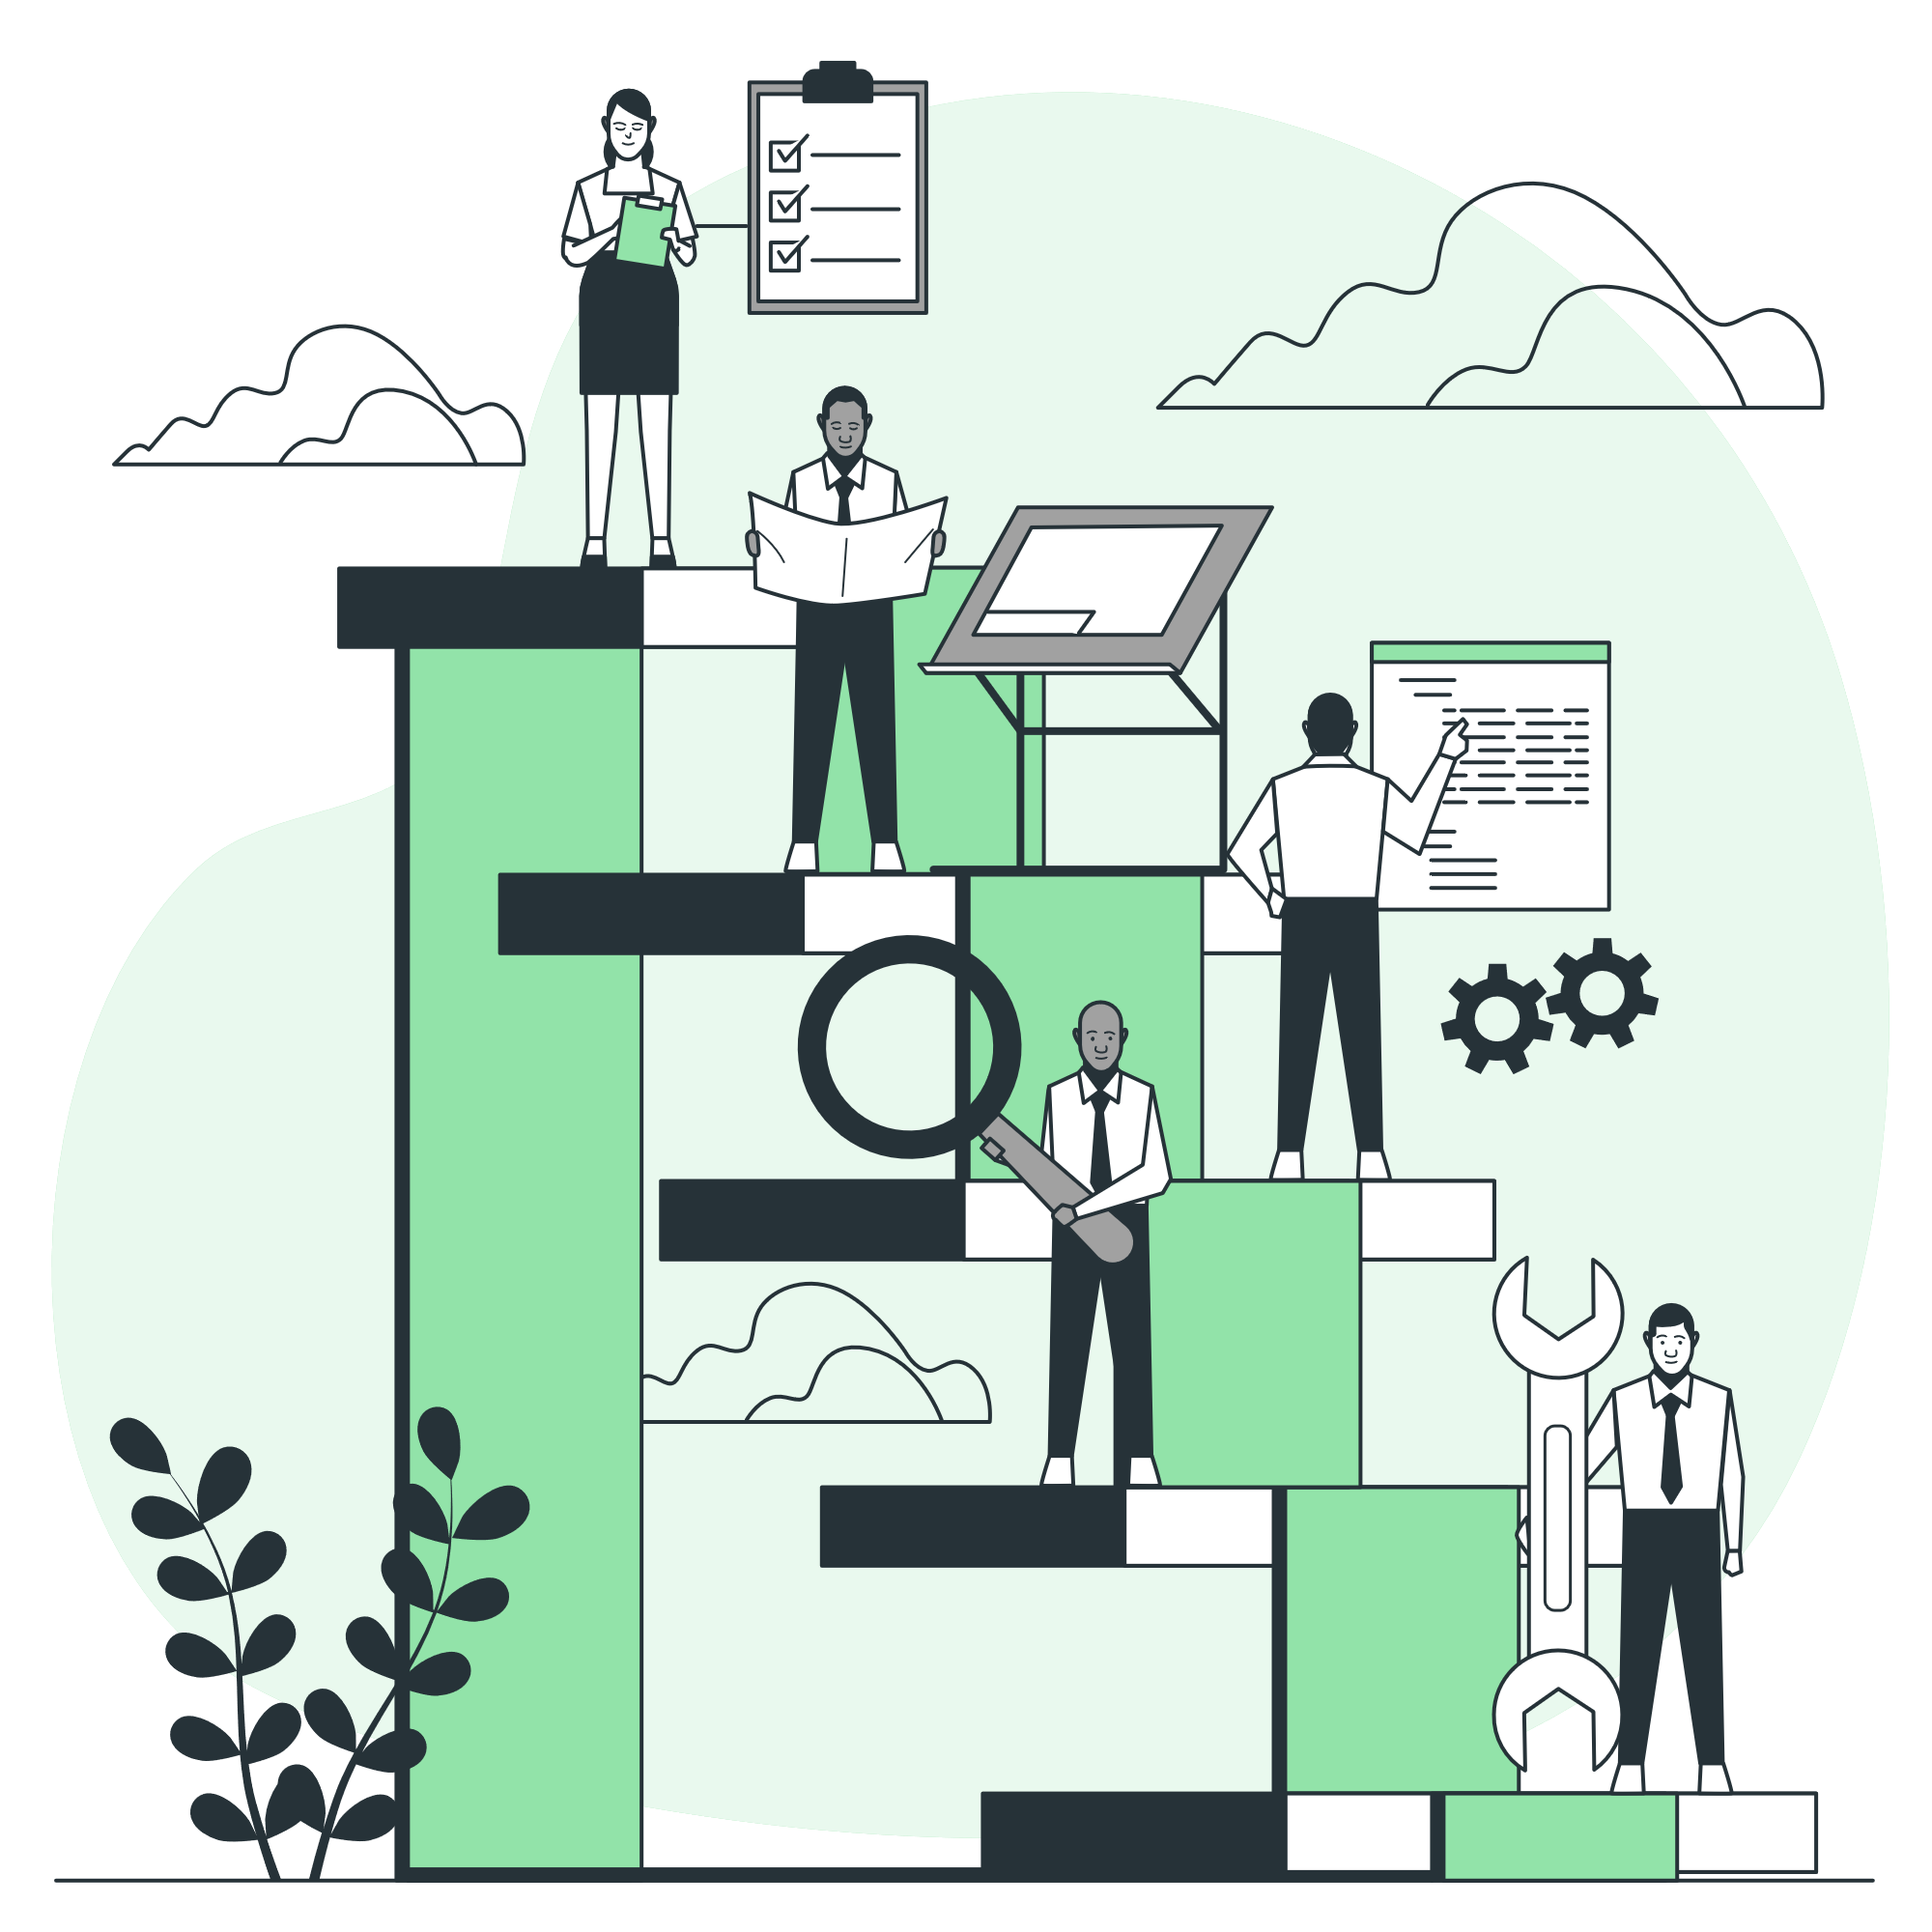
Methodology
Overview of Methodologies
Systematic approach for development
Ensured all stages were well-defined and sequential
Waterfall Model Phases
Requirements Analysis
System Design
Implementation
Integration and Testing
Deployment
Notes:
"In developing this project, I adopted a systematic approach to ensure that every stage of development was well-defined and followed sequentially. The methodology I chose was the Waterfall Model, which is a linear and structured approach to software development. This model helped me to maintain clarity and order throughout the project's lifecycle.
Waterfall Model Phases:
Requirements Analysis: This phase involved gathering and analyzing all necessary requirements for the project. It was crucial to understand what the end users needed and what the system should achieve.
System Design: Based on the requirements, I designed the system architecture, including both the frontend and backend components. This phase set the foundation for the subsequent development work.
Implementation: Here, I developed the actual code for the project, implementing the designs from the previous phase. This included writing the backend API with FastAPI and the frontend interface with React.
Integration and Testing: After implementation, I integrated all components and performed rigorous testing. This phase ensured that all parts of the system worked together seamlessly and met the required specifications.
Deployment: Once the system passed all tests, I deployed it to a live environment. This made the application accessible to end users.
By following these phases methodically, I was able to develop a robust and effective application."

Slide 8
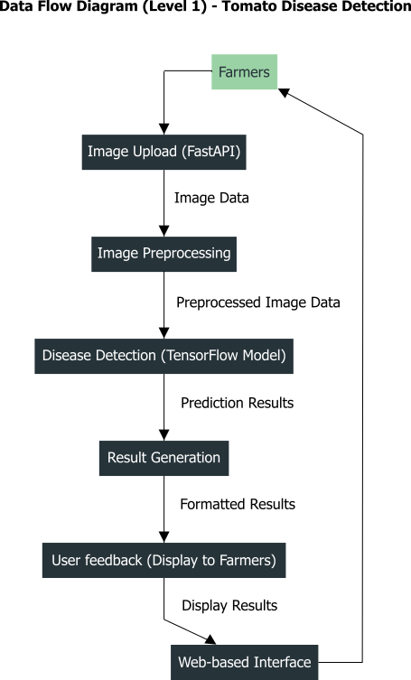
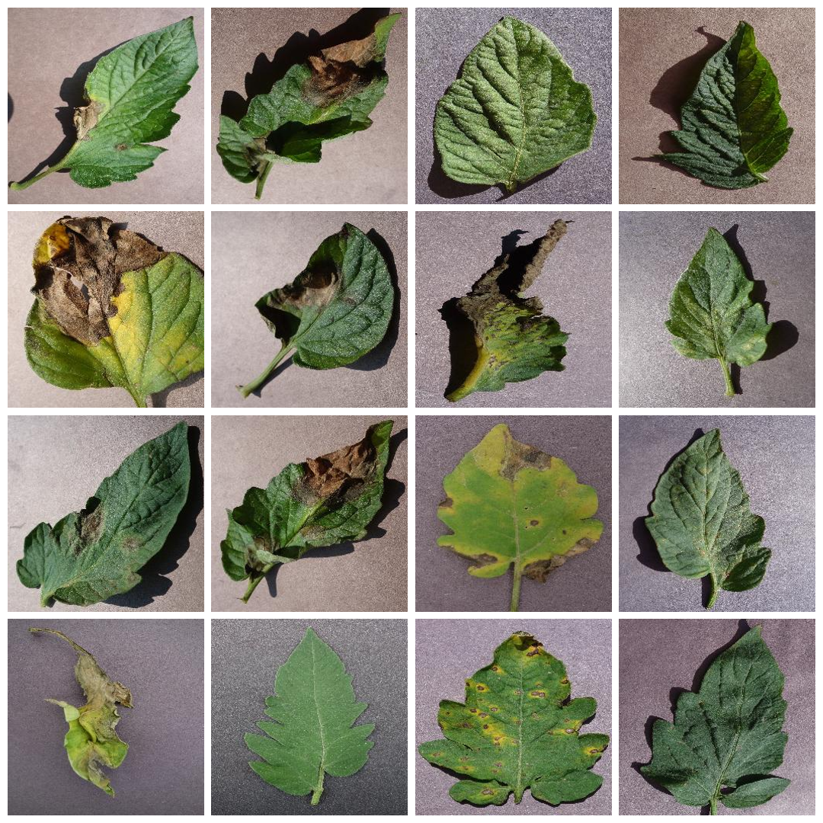
Data Flow Diagram (Level 1)
Notes:
"Next, let's examine the Data Flow Diagram for our project. This Level 1 diagram illustrates the primary data flow within our system. Here's how it works:
The user, in this case, a farmer, uploads an image of a tomato leaf.
The image is uploaded via FastAPI.
The uploaded image undergoes preprocessing to prepare it for analysis.
The preprocessed image is then fed into our TensorFlow model for disease detection.
The model generates a prediction and returns the result.
The prediction result is displayed back to the user through the web-based interface.
This user feedback loop ensures that farmers receive the necessary information quickly and efficiently.
This clear and structured data flow ensures seamless interaction between different components of the system, making the process efficient and user-friendly."

Slide 9
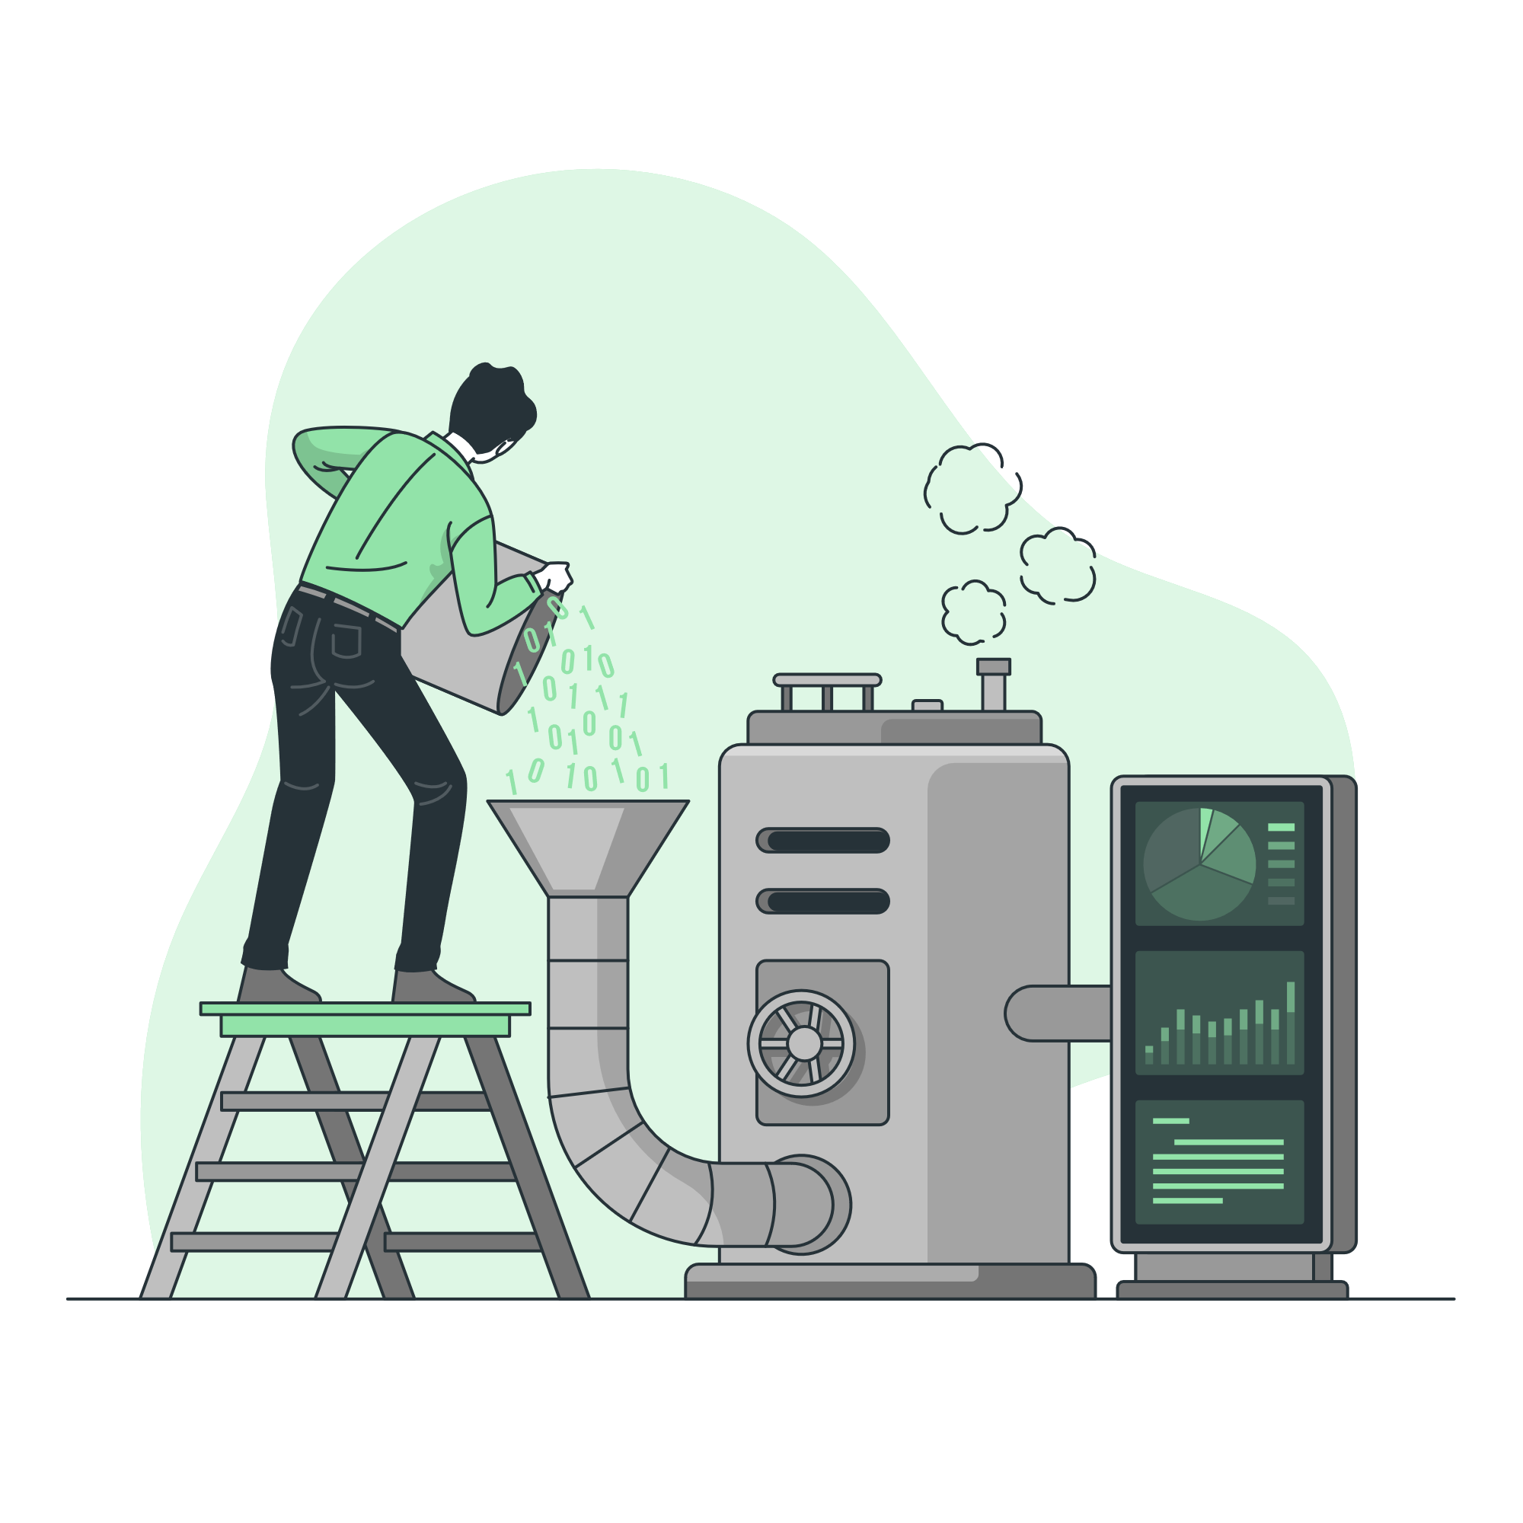
Image Preprocessing
Conversion to NumPy Array:
Enables numerical operations
Resizing and Normalization:
Matches model input size
Scales pixel values to [0, 1]
Preparing for Model Input:
Ensures correct shape and format
Notes:
"Next, I'll talk about image preprocessing, a critical step in preparing the data for my model.
First, the uploaded image is converted into a NumPy array. This conversion is crucial because it allows me to perform various numerical operations on the image data, which is essential for further processing and analysis.
The image is then resized to match the input size expected by the model. This step is necessary to maintain consistency across different images. Additionally, the pixel values are normalized, typically scaling them to a range of 0 to 1. Normalization ensures that the data scale is consistent, which helps the model learn more effectively.
Finally, the preprocessed image is reshaped and formatted to meet the input requirements of the TensorFlow model. This preparation includes ensuring the image has the correct dimensions and data type, which is critical for accurate predictions.
These preprocessing steps are essential to ensure that the images are in the right format and quality for accurate disease detection by my model."

Slide 10

Model Design and Implementation
Model Architecture
Sequential model with multiple layers
Convolutional layers for feature extraction
Dense layers for classification
Data Preparation
Image resizing and rescaling
Split into training and validation sets ( 80% Training, 10% Validation, 10% Testing)
Augmentation to enhance dataset
Notes:
"Let's delve into the design and implementation of the model used in this project.
Model Architecture:
The model is built using TensorFlow's Sequential API. It consists of multiple layers, starting with convolutional layers for feature extraction. These layers apply filters to the input image to detect various features like edges and textures.
The architecture includes multiple Conv2D layers with ReLU activation and MaxPooling2D layers to reduce the spatial dimensions of the feature maps. This combination helps in capturing essential features while reducing computational complexity.
The final layers are dense layers, with the last one having a softmax activation function to classify the input image into one of the ten classes of tomato leaf conditions.
Data Preparation:
I began by splitting the dataset into training and validation sets to evaluate the model's performance on unseen data. Data augmentation techniques, such as rotation and flipping, were applied to enhance the dataset's diversity and help the model generalize better. Images are first resized to a standard size of 256x256 pixels and rescaled to normalize the pixel values. This ensures that the model processes the images efficiently and consistently. Data augmentation techniques such as random flipping and rotation are applied to increase the diversity of the training data. This helps the model generalize better to unseen images.

Slide 11
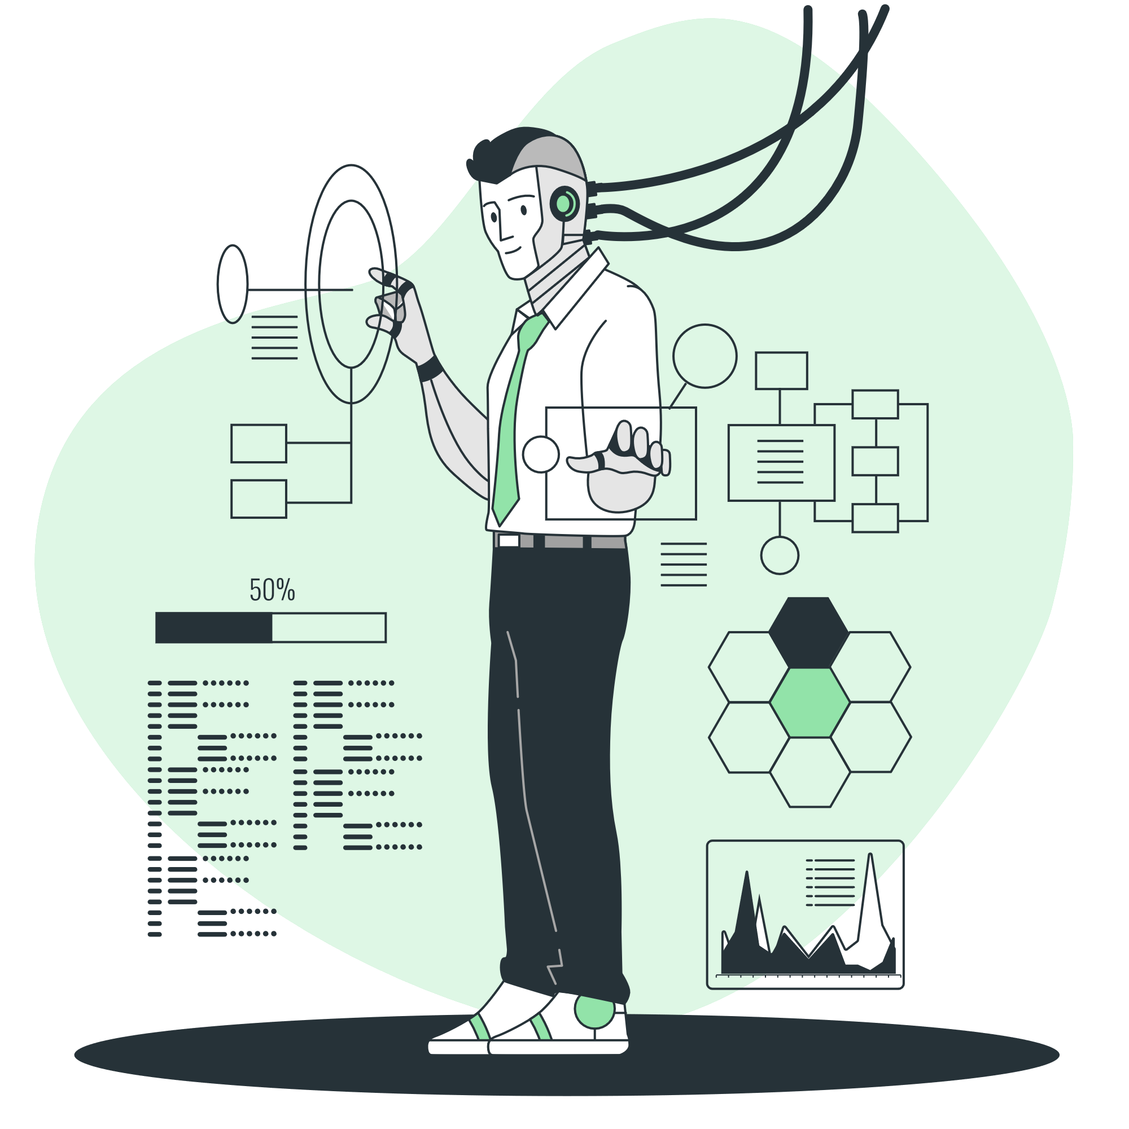
Model Training
Training Process
Model architecture: CNN
Loss function: Categorical Crossentropy
Optimizer: Adam
Epochs: 25
Validation
Monitor accuracy and loss
Early stopping to prevent overfitting
Notes:
"Next, I'll discuss the model training process.
Training Process: For training, I used a Convolutional Neural Network (CNN) architecture as previously mentioned, which is well-suited for image classification tasks. The categorical crossentropy loss function was chosen because it works well with multi-class classification problems. I used the Adam optimizer, which is efficient and widely used for training deep learning models. The training process ran for 25 epochs, balancing between sufficient learning and avoiding overfitting.
Validation: Throughout the training, I monitored accuracy and loss on the validation set. Early stopping was implemented to halt training when the validation performance stopped improving, preventing overfitting and ensuring the model remained generalizable to new data.

Slide 12
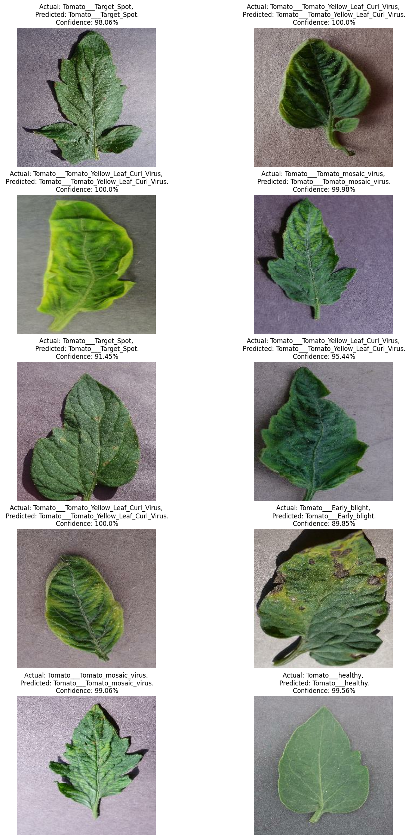
Testing Results
Notes:
After the model was trained I ran a few tests from the test dataset and here are a few results I got showing that the model was accurately classifying the images.

Slide 13
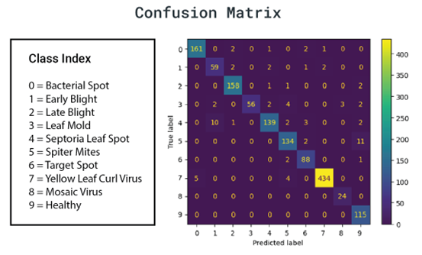
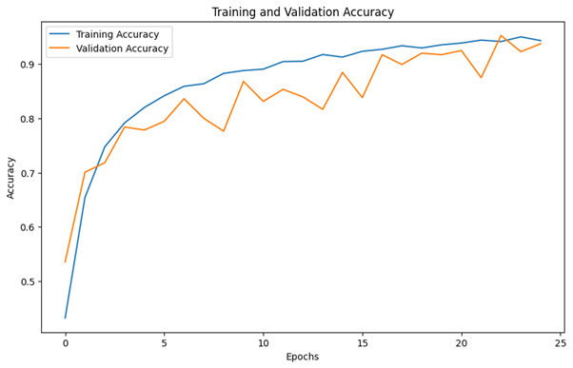
Model Evalution
Accuracy Plot
Confusion Matrix
Training and validation accuracy over epochs
Indicates model's learning progress
High values on the diagonal
True positives and misclassifications
Breakdown of class predictions
Notes:
"In evaluating my model, I focused on two main metrics: accuracy and the confusion matrix.
On the left, we have the accuracy plot. This graph shows the training and validation accuracy over different epochs. The model's accuracy improves steadily over time, with both training and validation accuracy converging towards a high value. This indicates that the model is effectively learning during the training process and is not overfitting, as the validation accuracy remains close to the training accuracy.
On the right, we have the confusion matrix, which provides a detailed breakdown of the model's performance. The high values on the diagonal indicate that the model is correctly predicting the true class labels for the majority of the samples. For instance, the model accurately identifies 'Healthy' leaves and 'Yellow Leaf Curl Virus' with high true positive rates. This diagonal dominance is a good sign, showing that the model performs well in distinguishing between different disease classes.
However, we can also see some off-diagonal values, which represent misclassifications. For example, there are a few instances where 'Spider Mites' are misclassified as 'Septoria Leaf Spot’.
These insights help in understanding where the model needs improvement and guide further refinements."

Slide 14
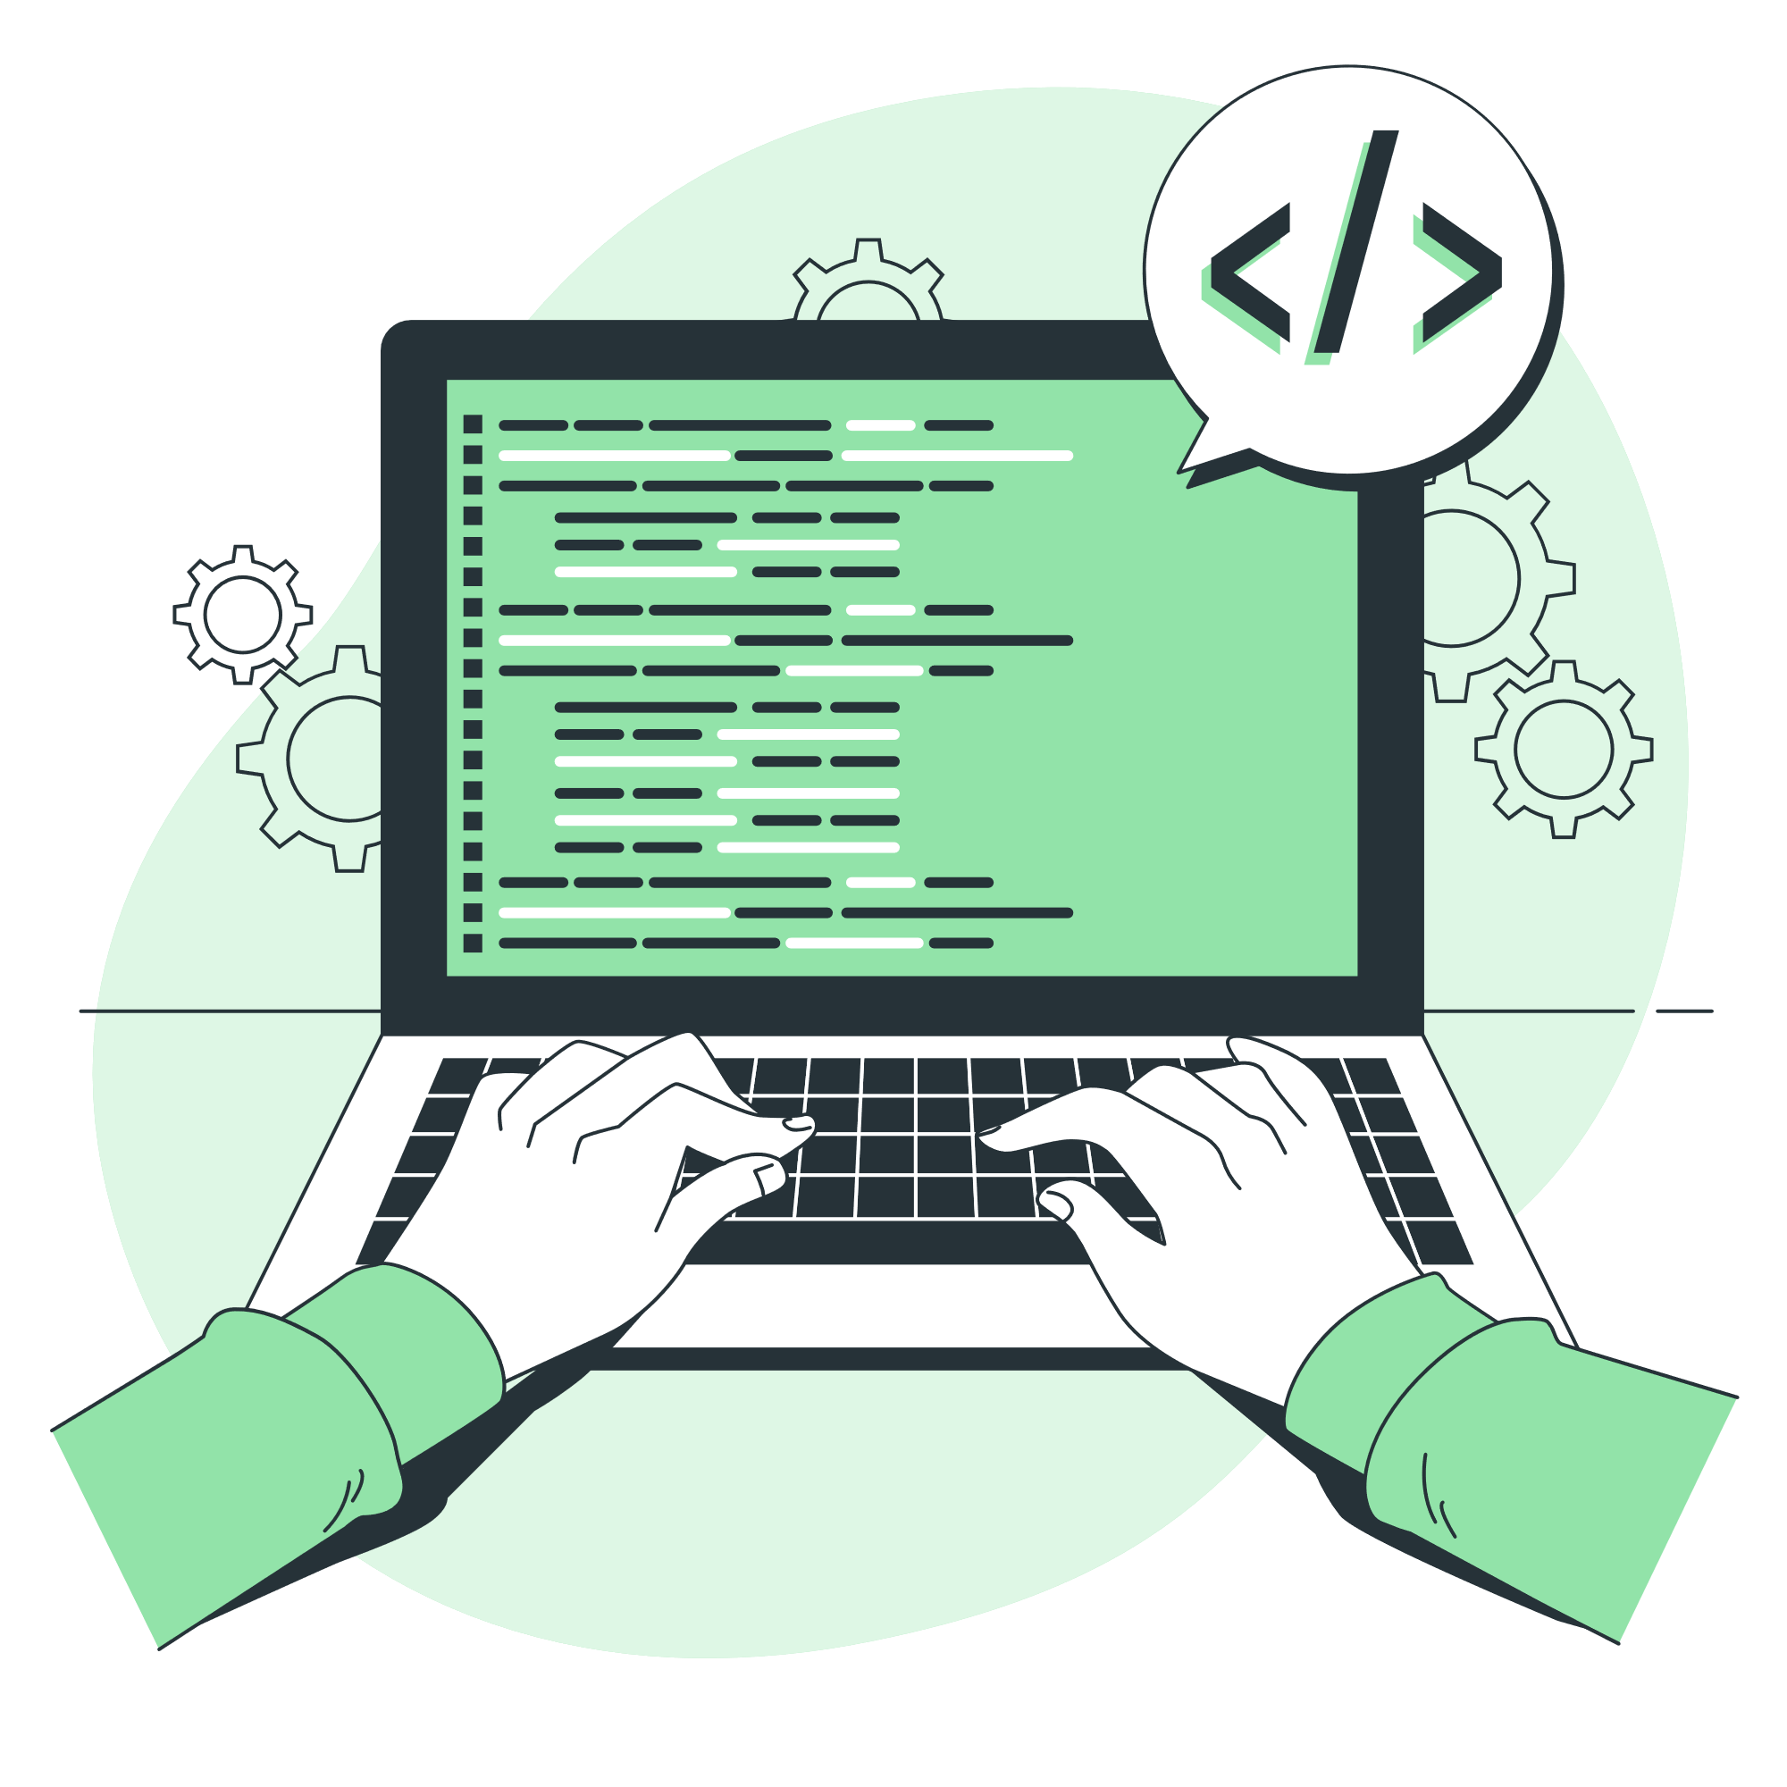
Web Application: Backend
Tools and Frameworks
FastAPI: For creating the API
TensorFlow: For loading and running the model
Key Functionalities
Image upload and processing
Model prediction and result generation
Endpoints
/ping: Test endpoint
/predict: Endpoint for image prediction
Notes:
"Now let's look at the backend development of the web application. The backend is the backbone of the application, handling all the logic and computations necessary to deliver the functionalities.
Tools and Frameworks:
FastAPI: I used FastAPI to create the API for the application. FastAPI is a modern, fast (high-performance), web framework for building APIs with Python. It is easy to use and has great performance, which was essential for this project.
TensorFlow: TensorFlow was used for loading and running the pre-trained model. TensorFlow is an open-source machine learning framework that allows for efficient model training and inference.
Key Functionalities:
Image Upload and Processing: The backend handles the uploading of images from the user. It processes these images to ensure they are in the correct format for prediction.
Model Prediction and Result Generation: Once the image is processed, the backend uses the TensorFlow model to predict the disease in the tomato leaf. It then generates a result that includes the predicted class and the confidence level.
Endpoints:
/ping: This is a simple test endpoint that checks if the server is running. It returns a string message when accessed.
/predict: This endpoint handles the core functionality of the application. It accepts an image file, processes it, runs the prediction using the TensorFlow model, and returns the prediction result.

Slide 15

Web Application: User Interface
ReactJS and MaterialUI
Modern and responsive design
Prebuilt components for faster development
Main Components
NavBar: Navigation and branding
UploadSection: Image upload and prediction
BodySection: Overall layout and background
Notes:
"Next, let's talk about the user interface of the web application. I used ReactJS and MaterialUI to build a modern and responsive design. MaterialUI provides prebuilt components that follow Google's Material Design guidelines, which allowed for faster development and a polished look.
The main components of the interface include:
NavBar: This component handles navigation and branding. It includes links to different sections like Home, Development, and Contact, making the application easy to navigate.
UploadSection: This is the core of the user interaction. It allows users to upload an image of a tomato leaf, which the backend will then process to predict the health condition. The section includes an upload button, a display area for the selected image, and a button to submit the image for prediction.
BodySection: This component provides the overall layout and background of the application. It ensures that the interface looks cohesive and visually appealing, with a fixed background and centralized content.
These components together create a user-friendly and efficient interface that enhances the overall user experience."

Slide 16

Web Application: User Experience
Design Goals
Modern and responsive design
Prebuilt components for faster development
Key Features
Simple upload process
Immediate feedback with predictions
Detailed information on detected diseases
Notes:
"Now, let's discuss the user experience, which was a crucial aspect of this project.
Design Goals:
My primary goal was to create a user-friendly and intuitive interface. I wanted users to navigate the application effortlessly and understand each function without any confusion.
Another critical goal was ensuring the application is fast and responsive across various devices, whether it's a desktop or mobile.
Key Features:
The application features a simple upload process. Users can easily upload an image of a tomato leaf by clicking a button, and the system takes care of the rest.
Once the image is uploaded, users receive immediate feedback with predictions on the health condition of the leaf. This quick response is vital for users who need fast answers.
Additionally, the application provides detailed information on any detected diseases, offering users valuable insights into the condition of their tomato plants and potential treatments.
These features collectively ensure that users have a smooth and efficient experience while using the application."

Slide 17
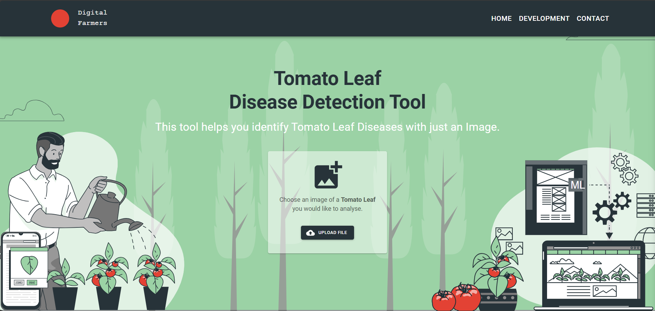
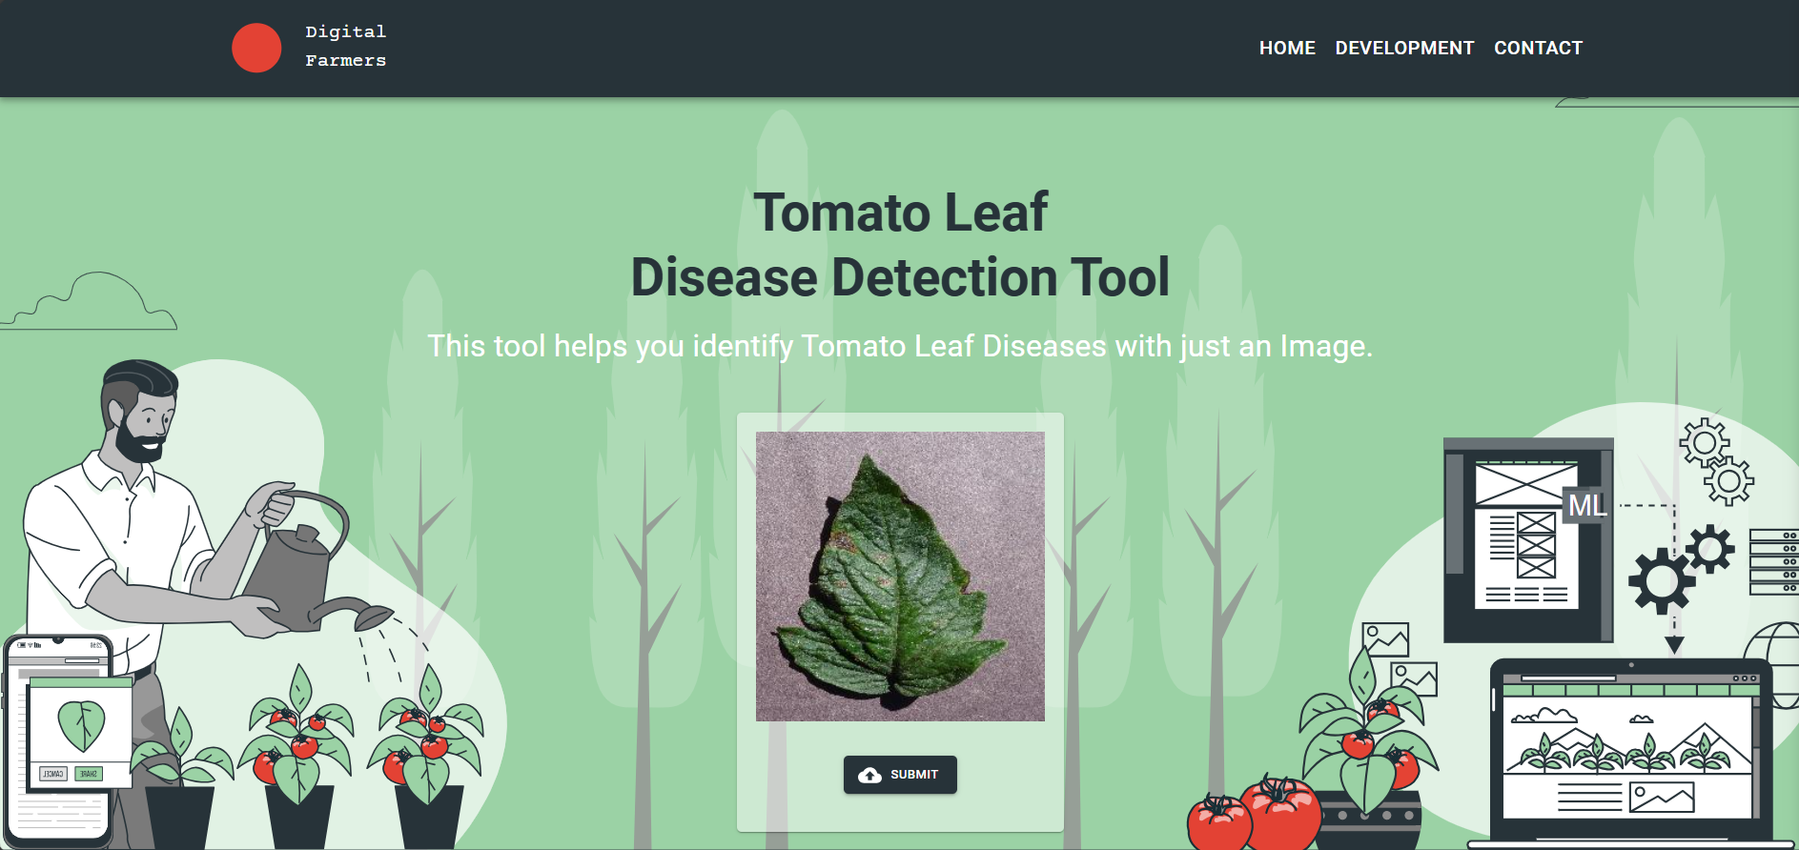
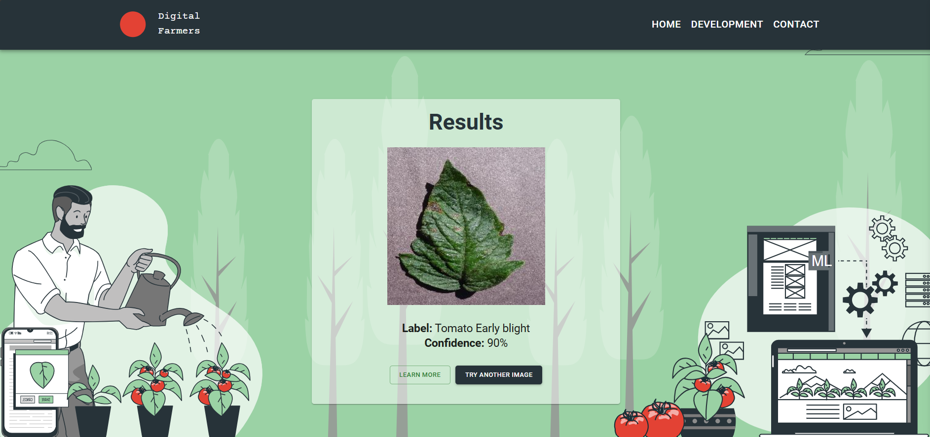
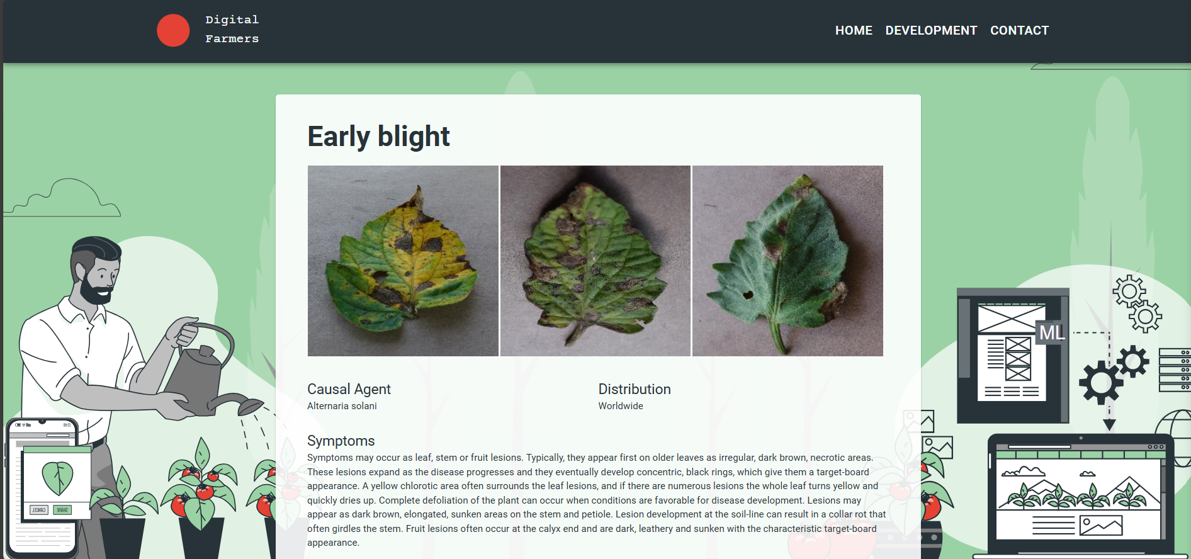
Desktop Screenshots

Slide 18
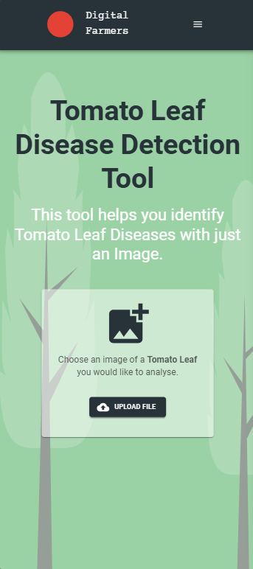
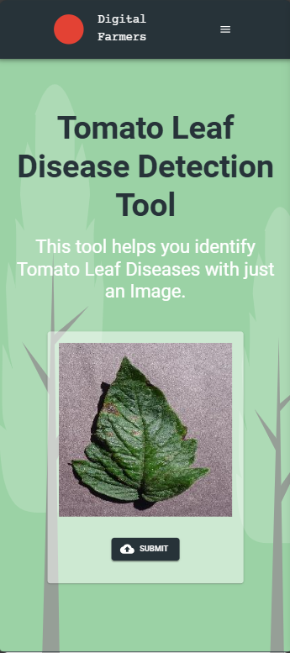
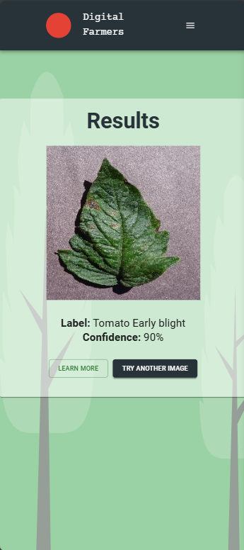
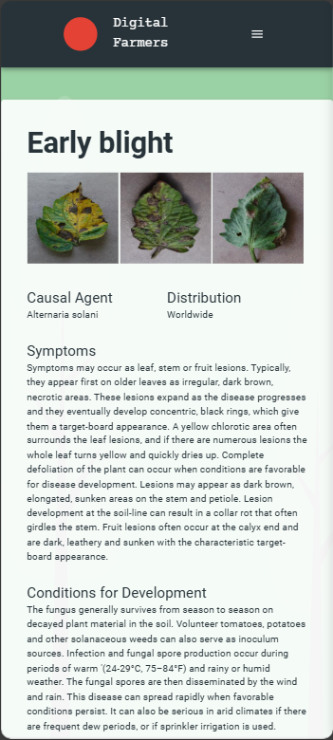
Mobile Screenshots

Slide 19
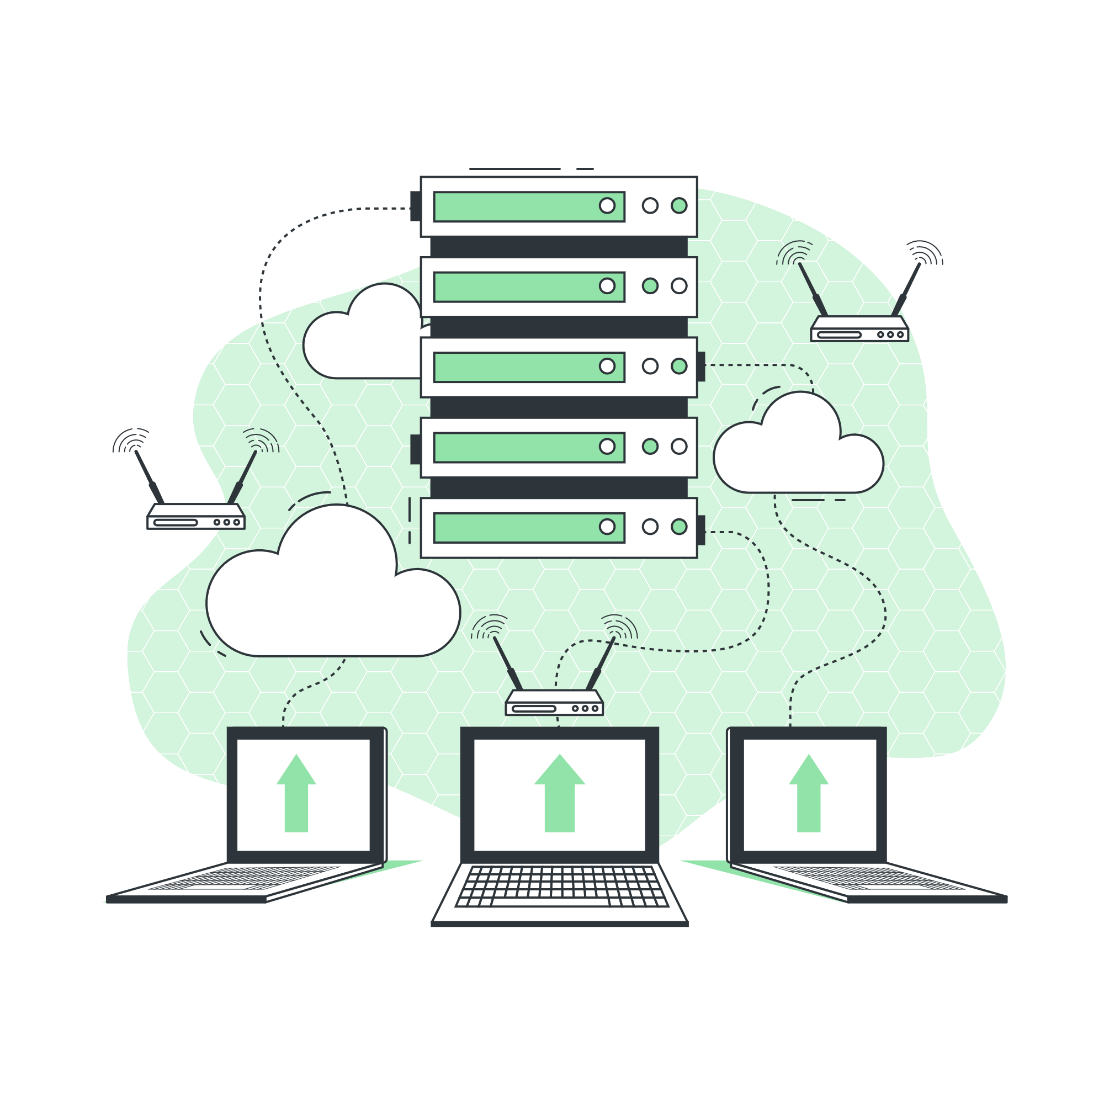
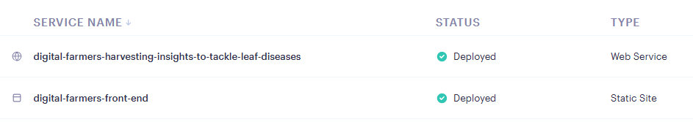
Deployment
Deployment on Render
Hosted the application on Render
Easy-to-use platform for deployment
Benefits and Features
Automatic scaling
Secure and reliable
Simplified deployment process
Notes:
"Next, let's talk about the deployment of the model.
Deployment on Render:
I chose to host the application on Render, a cloud platform that offers a simple and efficient way to deploy applications. Render supports a wide range of applications and services, making it a versatile choice for deployment needs.
Benefits and Features:
Automatic scaling: Render automatically scales the application based on demand. This means that during high traffic periods, the application will scale up to handle the load, ensuring smooth performance.
Secure and reliable: Render provides robust security features, including automatic HTTPS, DDoS protection, and regular backups. These features help ensure that the application remains secure and reliable.
Simplified deployment process: Deploying the application on Render is straightforward, with minimal configuration required. Render supports continuous deployment from GitHub, making it easy to deploy updates and new features.
By using Render, I was able to deploy the application quickly and efficiently, ensuring that it is accessible to users with minimal downtime and high reliability."

Slide 20
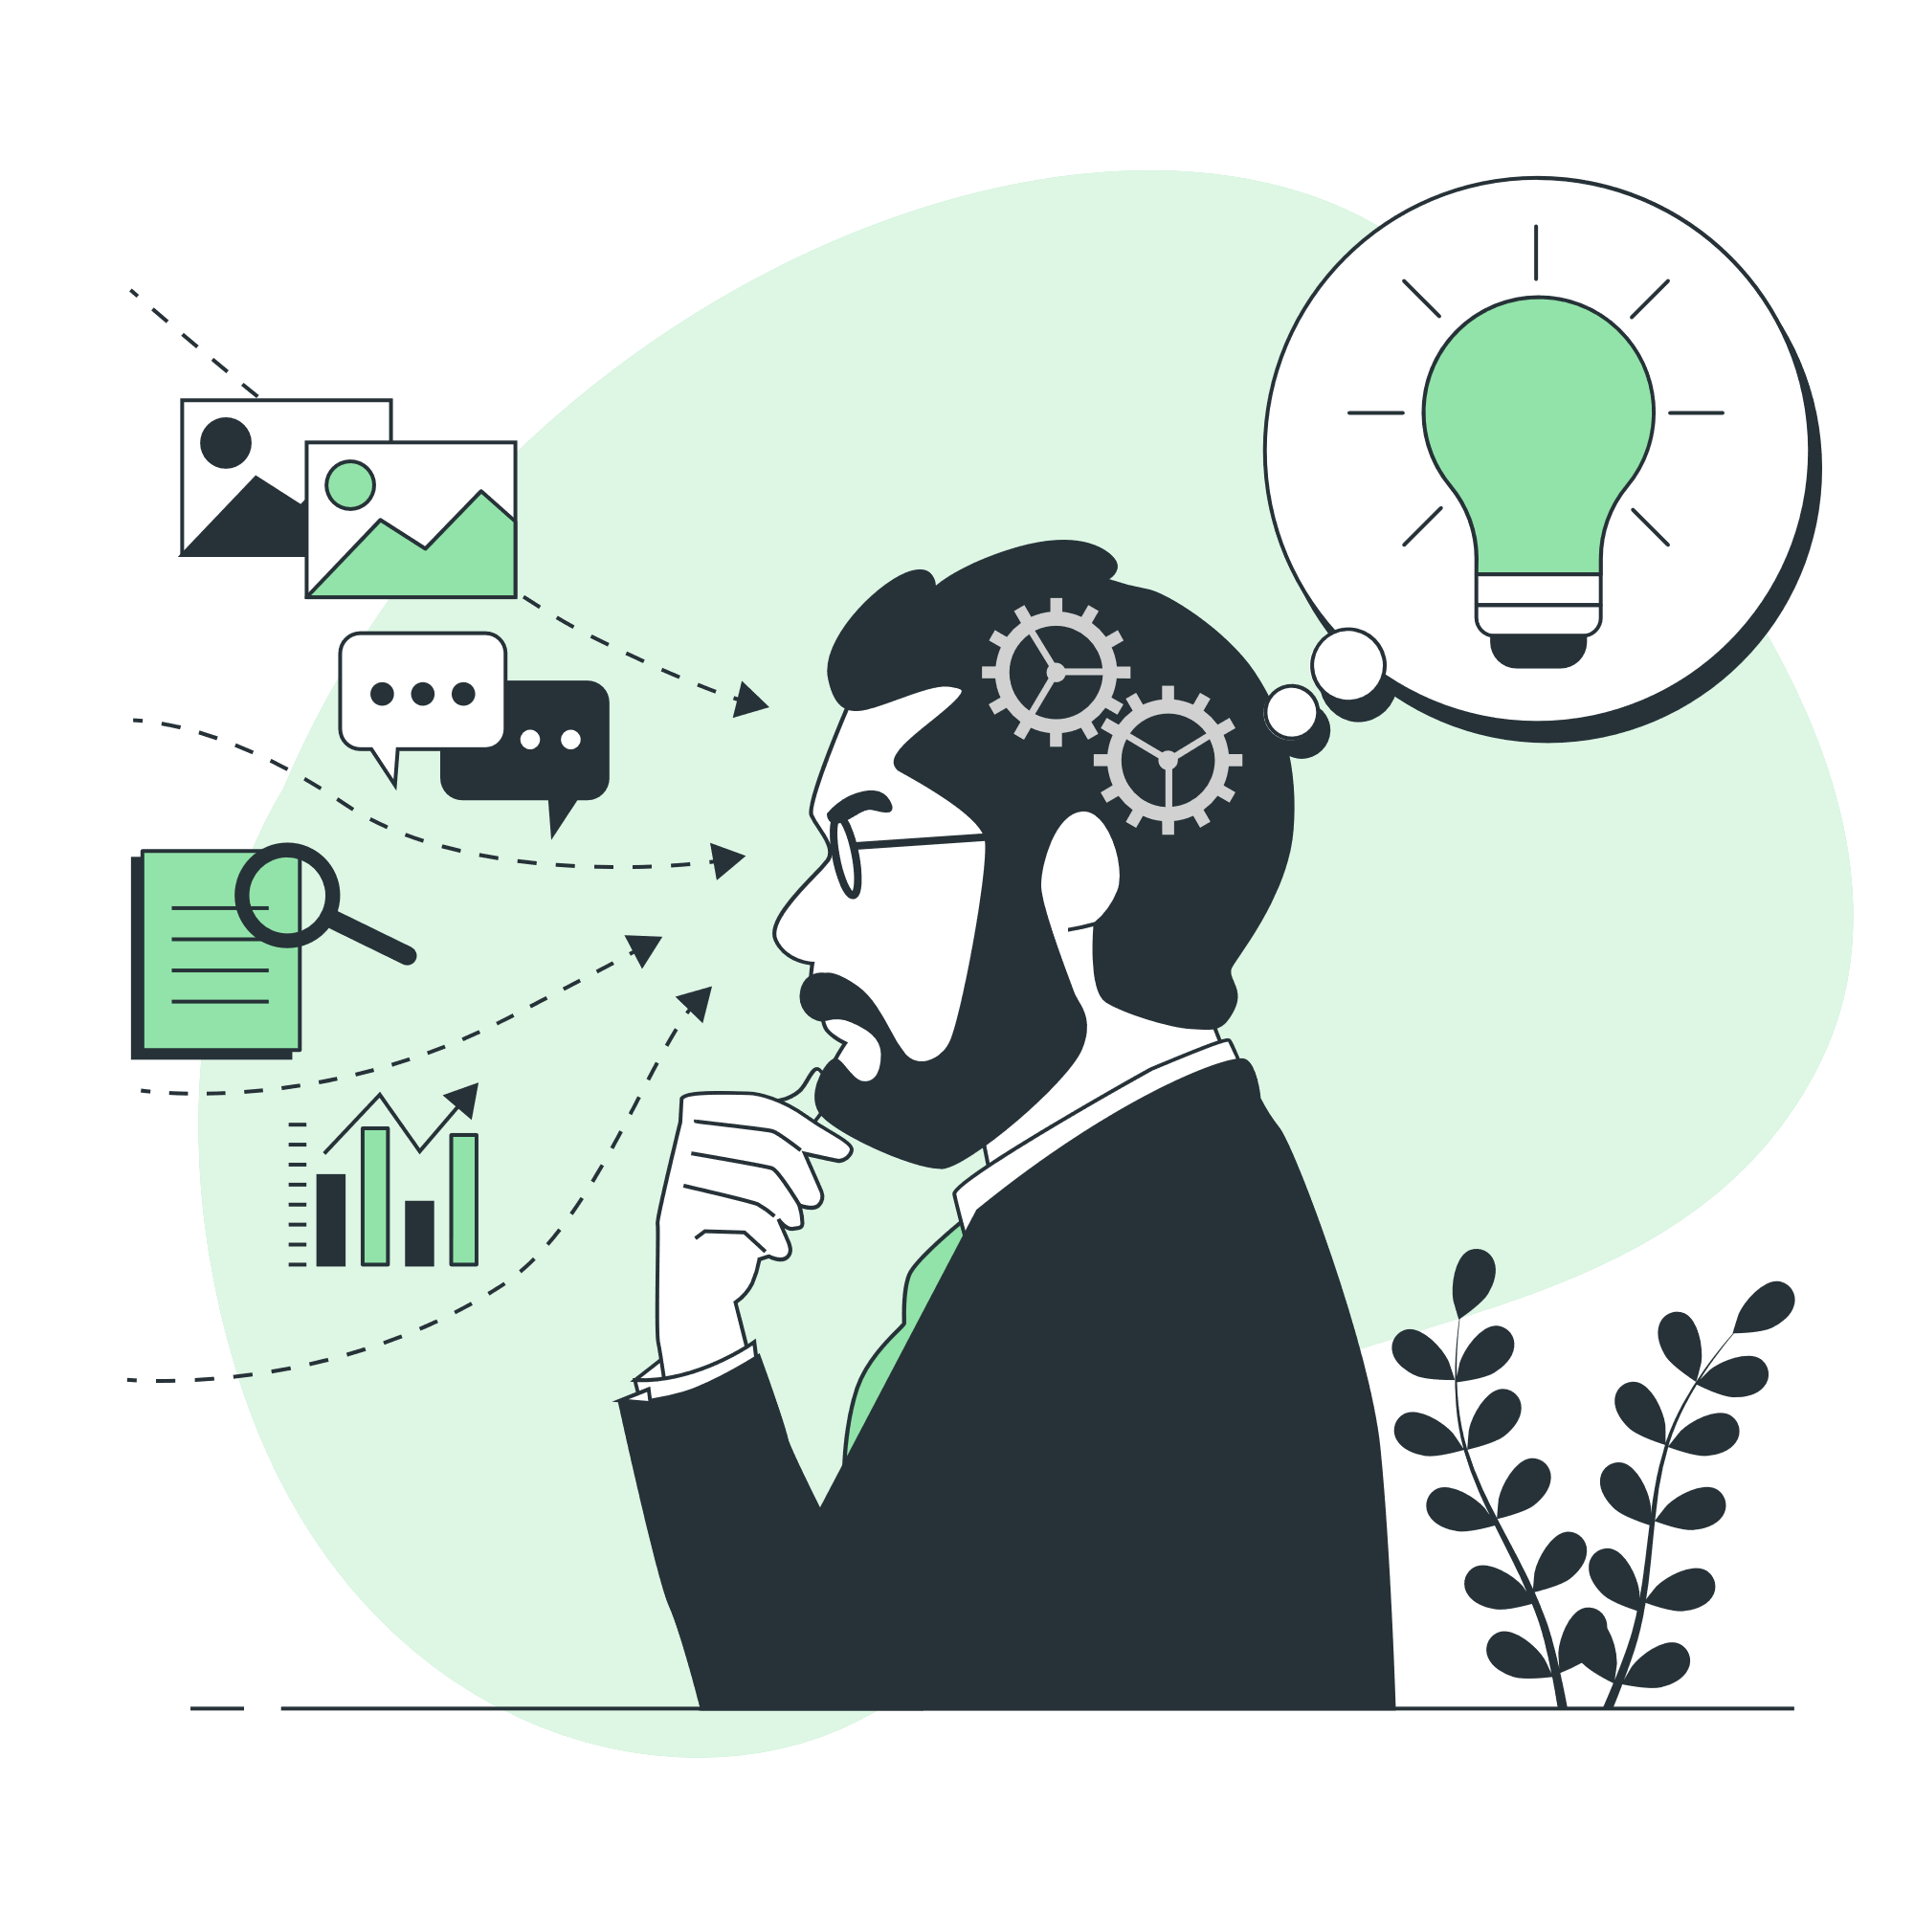
Challenges and Solutions
Challenges
Integrating multiple technologies
Ensuring accurate predictions
Handling various image qualities
Solutions
Detailed planning and research
Extensive model training and validation
Image preprocessing techniques
Notes:
"Every project faces its fair share of challenges, and this one was no exception. Let's go over some of the key challenges I encountered and the solutions I implemented to overcome them.
Challenges:
Integrating multiple technologies: Combining ReactJS for the frontend, FastAPI for the backend, and TensorFlow for the machine learning model required meticulous integration to ensure everything worked seamlessly together.
Ensuring accurate predictions: Achieving high accuracy in predictions was crucial for the success of this application. This involved selecting the right model architecture and extensive tuning of hyperparameters.
Handling various image qualities: Users could upload images of varying qualities, which could affect the model's performance. Ensuring the model could handle these variations was a significant challenge.
Solutions:
Detailed planning and research: Before diving into coding, I invested time in planning and researching the best practices for integrating these technologies. This foundation helped mitigate many integration issues.
Extensive model training and validation: To ensure accurate predictions, I trained the model on a diverse dataset and conducted rigorous validation. This process helped fine-tune the model and improve its performance.
Image preprocessing techniques: To handle various image qualities, I implemented image preprocessing techniques such as resizing, normalization, and augmentation. These techniques helped standardize the input images and improve the model's robustness.
By addressing these challenges head-on with these solutions, I was able to develop a robust and reliable application."

Slide 21
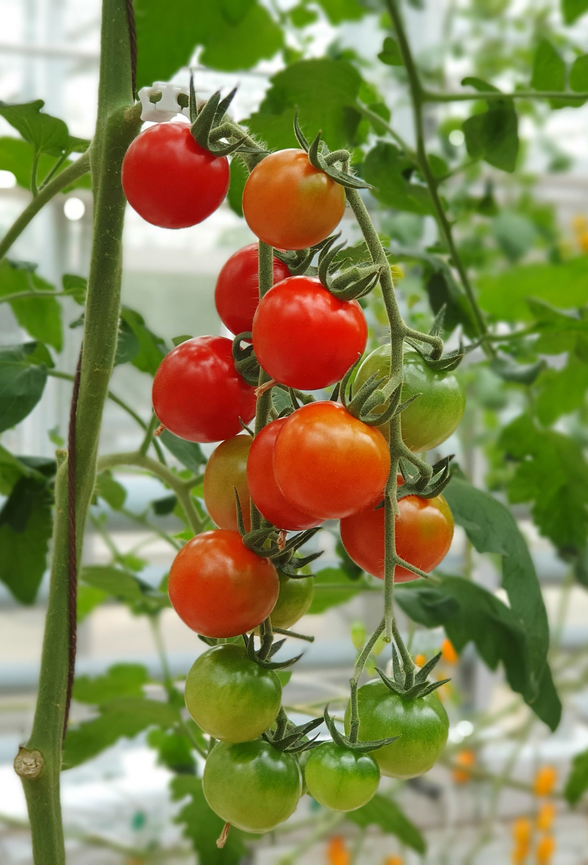
Future Works
Enhancements:
Improve model accuracy and performance
Add support for more diseases
Enhance user interface
Additional Features:
Implement advanced image preprocessing
Add real-time prediction capabilities
Include multi-language support
Notes:
"Looking forward, there are several areas where I plan to enhance and expand this project.
Enhancements:
Improve model accuracy and performance: By retraining the model with a larger and more diverse dataset, I aim to increase its accuracy and robustness in predicting tomato leaf diseases.
Add support for more diseases: Expanding the model to recognize a wider variety of plant diseases will make the tool even more useful for farmers and gardeners.
Enhance user interface: I plan to refine the frontend to make it more user-friendly and visually appealing, ensuring a better user experience.
Additional Features:
Implement advanced image preprocessing: Techniques like image augmentation and normalization can further improve the model’s accuracy and reliability.
Add real-time prediction capabilities: This would allow users to receive instant feedback, making the tool more practical for on-the-go use.
Include multi-language support: To reach a broader audience, I intend to add support for multiple languages, making the application accessible to non-English speaking users.
These future enhancements and additional features will not only improve the functionality of the application but also expand its usability and impact."

Slide 22
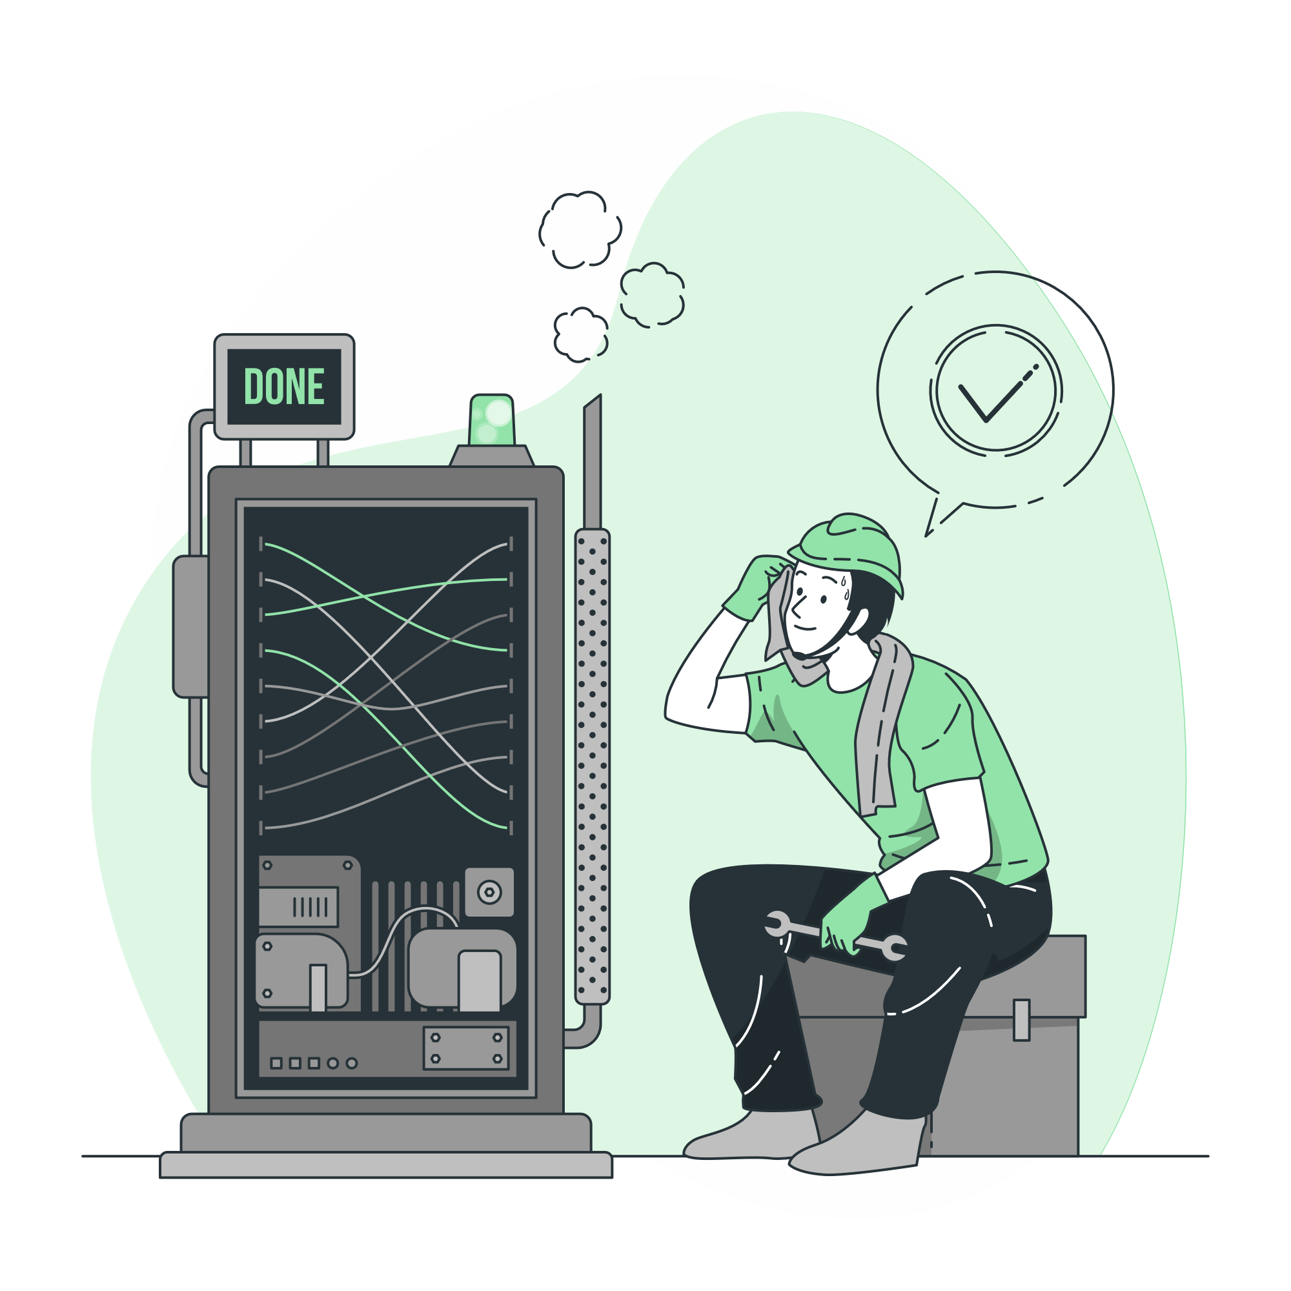
Conclusion
Summary
Utilized ReactJS, FastAPI, and TensorFlow
Developed a web app for tomato leaf disease detection
Reflection
Effective integration of technologies
Lessons learned and future improvements
Notes:
"In conclusion, this project successfully utilized a combination of technologies to develop a web application for detecting tomato leaf diseases. Let’s summarize the key points and reflect on the overall process.
Summary:
I used ReactJS for building a responsive and interactive frontend, FastAPI for creating a robust backend API, and TensorFlow for developing a machine learning model capable of accurately predicting tomato leaf diseases.
The result is a web application that allows users to upload images of tomato leaves and receive predictions about potential diseases, helping farmers make informed decisions about their crops.
Reflection:
The integration of these technologies was effective, allowing each component to work seamlessly together. This project demonstrated the power of combining modern web development frameworks with advanced machine learning techniques.
Throughout the project, I learned valuable lessons about the importance of planning, testing, and validating each component to ensure a smooth and functional application.
Looking ahead, there are areas for future improvement, such as enhancing the user interface, expanding the model to detect more types of diseases, and implementing more advanced image preprocessing techniques.
Overall, this project not only achieved its primary goal of creating a functional application but also provided me with significant insights and experience in software development and machine learning."

Slide 23
Thank You!
Do you have any questions?
Name: Seward Richard Mupereri
Student ID: 20140175
Supervisor: Dr. Ferhun Yorgancıoğlu
Project Website:
https://digital-farmers-front-end.onrender.com/

